Slide 1
Geochemistry (433G)
2019-2020
1st lecture
Dr. M.M. Mogahed

Slide 2
What is Geochemistry??
Victor Goldschmidt defined the study of geochemistry as: “the laws governing the distribution of the chemical elements and their isotopes throughout the earth”
What does that mean?
We are interested in understanding the different ways in which elements move → whether in the core, mantle, crust, oceans, sediments, air, space, or other planets…

Slide 3
What is the difference between Geology & Geochemistry?
  Geology is direct observation and interpretation of field relations to infer history and present state (e.g. hazards and resources) of the solid Earth and its regions
    structural geology, geomorphology, stratigraphy, paleontology, petrology, mineralogy, volcanology...
  Geochemistry is the application of principles of chemistry to understanding the Earth (solid, ocean, and atmosphere)
    Fundamental principles such as radioactive decay, conservation of elemental and isotopic mass, thermodynamics and kinetics bring rigor and certainty to geological interpretation
  Likewise, geophysics and geobiology bring the applications of physics and biology to the interpretation of geological observation and inference
  The other sciences are needed to limit the speculation of geologists to plausible ideas, but geology is the anchor of Earth science: it provides the problems to be solved, and the record of actual events.

Slide 4
Fundamentals of Geochemistry
The Periodic Table
  Alkali & alkaline earths: K, Rb, Sr, Cs, Ba, Li
  Transition metals: Sc, Ti, V, Cr Co, Ni, Cu, Zn, Pb, Sn, Bi
    Different valence (oxidation) states; high electronegtivity
  Rare earth elements (lanthanides)
    High charge, large radii
  High Field Strength Elements: Zr, Hf, Ta, Nb
    High ionic charge +4 - +5; smaller radii
  Noble metals: Pt, Au, Pd, Rh, Os
    Rare & unreactive
  Gases/Volatiles: He, Ne, Ar, Kr, Xe, C, S, Cl

Slide 5
Major & Trace Elements
Major Elements
  make up the majority of silicates (crust and mantle)
  Si, O, Al, Fe, Mg, Na, K, Ca, (Mn), (Ti), (S), (P)
  Reported as Wt % oxide or mg/Kg
Trace Elements
  the remaining elements, but vary depending on the geochemical system under study. For example, trace elements in igneous rocks not same as oceanic ones
  Generally reported as ppm or μg/Kg

Slide 6
Chemical characteristics
The more common rock constituents are nearly all oxides; chlorides, sulfides and fluorides
F. W. Clarke has calculated that a little more than 47% of the Earth's crust consists of oxygen. It occurs principally in combination as oxides, of which the chief are silica, alumina, iron oxides, and various carbonates (calcium carbonate, magnesium carbonate, sodium carbonate, and potassium carbonate).
The silica functions principally as an acid, forming silicates, and all the commonest minerals of igneous rocks are of this nature.

Slide 7
These oxides combine in a haphazard way.
For example, potash (potassium carbonate) and soda (sodium carbonate) combine to produce feldspars. In some cases they may take other forms, such as nepheline, leucite, and muscovite, but in the great majority of instances they are found as feldspar.
Phosphoric acid with lime (calcium carbonate) forms apatite.
Titanium dioxide with ferrous oxide gives rise to ilmenite.
Part of the lime forms lime feldspar.
Magnesium carbonate and iron oxides with silica crystallize as olivine or enstatite, or with alumina and lime form the complex ferro-magnesian silicates of which the pyroxenes, amphiboles, and biotites are the chief.
Any excess of silica above what is required to neutralize the bases will separate out as quartz; excess of alumina crystallizes as corundum
It is possible, by rock analysis, to say approximately what minerals the rock contains, but there are numerous exceptions to any rule.

Slide 8
Mineral constitution
We may say that except in acidic or siliceous rocks containing 66% of silica, known as felsic rocks, quartz is not abundant in igneous rocks.
In basic rocks (containing 20% of silica or less) it is rare (Quartz) and accidental.
If magnesia and iron be above the average while silica is low, olivine may be expected; where silica is present in greater quantity over ferro-magnesian minerals, such as augite, hornblende, enstatite or biotite, occur rather than olivine.
Unless potash is high and silica relatively low, leucite will not be present, for leucite does not occur with free quartz. Nepheline, likewise, is usually found in rocks with much soda and comparatively little silica.
With high alkalis, soda-bearing pyroxenes and amphiboles may be present.
The lower the percentage of silica and the alkalis, the greater is the prevalence of calcium feldspar as contracted with soda or potash feldspar.

Slide 9
Physical conditions
Certain minerals are practically confined to deep-seated intrusive rocks, e.g., microcline, muscovite.
Leucite is very rare in plutonic masses; many minerals have special peculiarities in microscopic character according to whether they crystallized in depth or near the surface, e.g., hypersthene, orthoclase, quartz.
There are some curious instances of rocks having the same chemical composition, but consisting of entirely different minerals,

Slide 10
E.g., the hornblendite which contains only hornblende, has the same composition as some of the camptonites.
Although Hornblendite is a plutonic rock consisting mainly of the hornblende. Hornblende-rich ultramafic rocks are rare and when hornblende is the dominant mineral phase they are classified as hornblendites.
Moreover, metamorphic rocks composed dominantly of amphiboles are referred to as amphibolites.
(A camptonite is a porphyritic alkaline igneous rock dominated by essential plagioclase and brown amphibole, usually hornblende, often with titanaugite. Plagioclase occurs in the groundmass).

Slide 11
In rhyolites and trachytes, early crystals of hornblende and biotite may be found in great numbers partially converted into augite and magnetite.
Hornblende and biotite were stable under the pressures and other conditions below the surface, but unstable at higher levels. In the ground-mass of these rocks, augite is almost universally present.
But the plutonic representatives of the same magma, granite and syenite contain biotite and hornblende far more commonly than augite.

Slide 12
Classification of chemical elements
Major elements
– Comprise most of the rock
– Expressed as weight (wt.) % oxides, each >0.1%
– Analyzed by XRF, ICP-MS
Trace elements
– Present in concentrations <0.1%
– Expressed in ppm or ppb
– Analyzed by XRF, ICP-MS, INAA
• Volatile elements
– H₂O, CO₂, SO₄
– Rare gases: He, Ar, Ne, etc.
– Analyzed by spectroscopy or mass spectrometry
Radiogenic isotopes
– Ratios of radiogenic to nonradiogenic isotopes of an element
recall isotopes of an element have same atomic no., but variable # of neutrons
– Variations in ratios reflect differences produced over time by radioactive decay in source
– Variations are extremely small: analyzed by magnetic sector mass spectrometry
Stable Isotopes
– Lighter masses fractionated by geological processes
– Analyzed by magnetic sector mass spectrometry

Slide 13
Major elements
A. Bivariate plots and their interpretation; differentiation
Harker diagrams: SiO₂ vs. oxide.
The meaning of geochemical trends: can be interpreted as magmatic “evolution” from “primitive” to “differentiated” rocks. More or less implicitly assumes fractional crystallization.
The nature of the phases crystallizing can be inferred from the shape of the trends. Ex.: decreasing Fe, Mg = precipitation of mafic minerals.

Slide 14
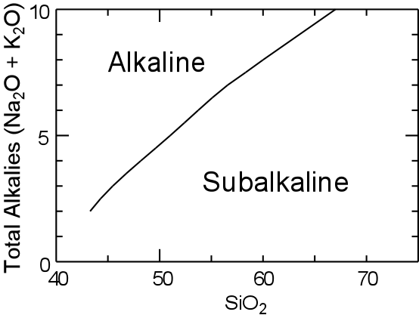
Major elements
B. Magmatic series
Magmatic series: reflect first order differences between rock groups.
TAS diagram separates alkali and sub-alkali series

Slide 15
In addition, important role of the relative proportions of Al₂O₃ and CaO-Na₂O-K₂O
A>CNK: Peraluminous rocks. Have Al-rich minerals such as biotite, muscovite, garnet, cordierite…
A<CNK:
A>NK: Metaluminous. No particular minerals, mafics are pyroxene, amphibole, biotite
A<NK: peralkaline rocks. Alkali-rich minerals such as alkali amphiboles and pyroxenes.

Slide 16
II.Trace elements
In geochemistry, a trace element is a chemical element whose concentration is less than 1000 ppm or 0.1% of a rock's composition.
Trace elements will either prefer liquid or solid phase.
If compatible with a mineral, it will prefer a solid phase (e.g., Ni compatible with Olivine).
If it is incompatible with an element it will prefer a liquid phase.
The measurement of this ratio is known as the partition coefficient.
Trace elements can be substituted for network-forming cations in mineral structures. Minerals do not have to contain trace elements, i.e., they do not have to appear in the mineral's chemical formula.
Substitutions occur between elements that have…
Same charge
Similar ionic radii

Slide 17
Plotting Trace Elements
Spidergrams allow to
See many elements at a time
Compare elements with large differences of absolute abundance (log scale!)
To some degree, make petrogenetic interpretations
Making a spidergram
For each sample, arrange elements in order of increasing compatibility (i.e., the more incompatible at the left). (technically, this implies a different order for each different source!).
Plot the normalized value of each elements (log scale!)
Link the dots
Look at the “anomalies”
Some classical spidergrams:
REE diagrams (n’ed to chondrites or PRIMA=PRImitive MAntle in general)
Multi-element diagrams for incompatible elements (N’ed to PRIMA/chondrites, or to MORBs)
PGE diagrams
Transition metal diagrams

Slide 18
Structure and Physical Properties of Silicate Melt

Slide 19
Magma Compositions
Magma is liquid rock (and generally contains crystals and dissolved gas) and can have a variety of compositions:
  Silicate
  Carbonatite – rare
  Sulfur - remobilization of volcanic exhalative sulfur - low melting T (115˚ C); restricted volumes
  Sulfide - very rare, develops by exsolution from silicate magmas, limited volumes
  Phosphate-Iron Oxide - extremely rare, origin uncertain
Silicate magmas represent >99.9% of all terrestrial magmas and will be our focus.

Slide 20
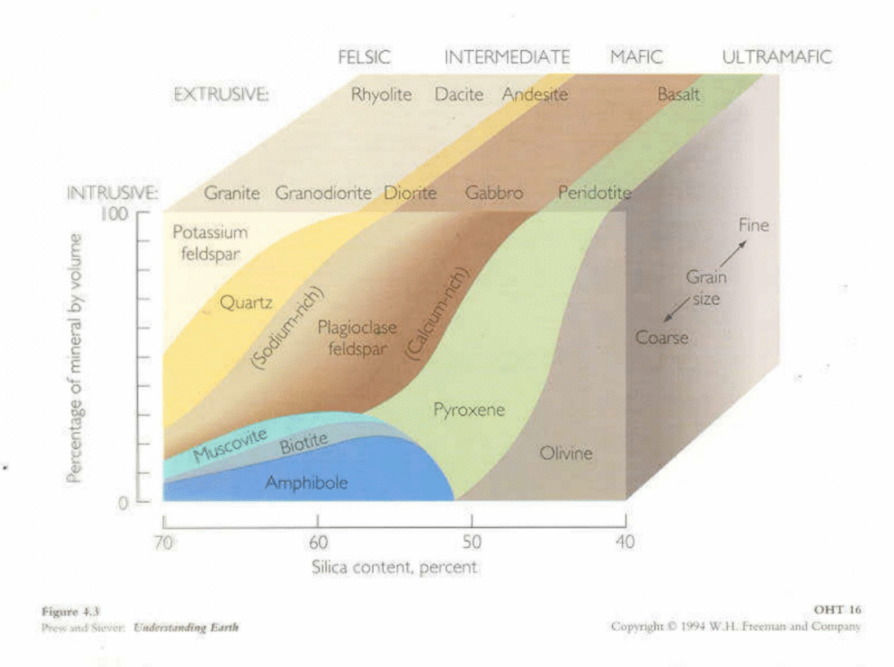
Silicate Magma Compositions

Slide 21
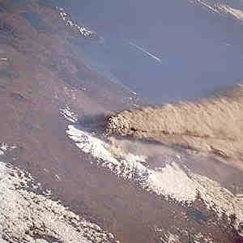
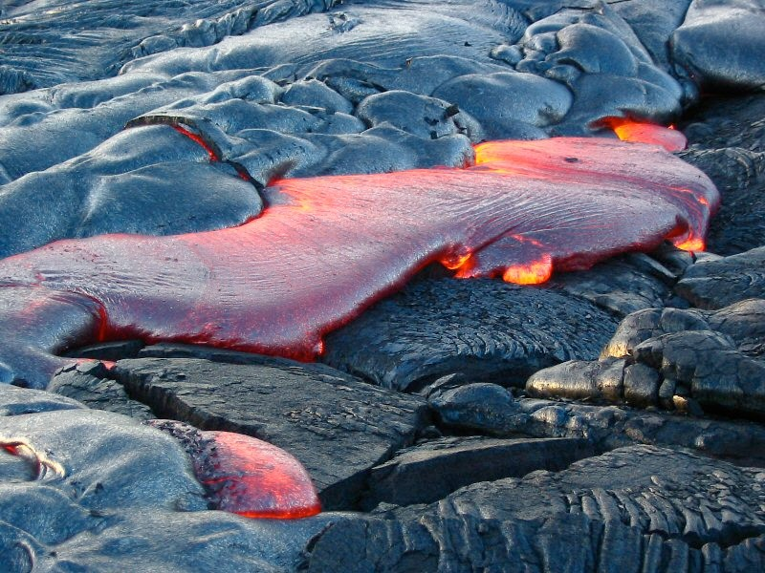
What controls eruption style?
Why are some volcanic eruptions explosive and others effusive?
The answer has to do with both composition and physical properties.

Slide 22
Important physical properties
Temperature
Density
Viscosity
Gas solubility

Slide 23


Structure of Silicates & Silicate Melts
To understand the behavior of silicate melts, we begin by examining their structure at the molecular level.
The molecular structure of silicate melts is a lot like that of silicate solids.
The basic building block is the silica tetrahedron:
  4 large oxygens surrounding a
  small silicon atom.
  Has a valence of -4.

Slide 24
There are five common silicon–oxygen tetrahedra links:
Independent tetrahedra
Single chains
Double chains
Sheet silicates
Framework silicates
Independent tetrahedra
In this group the tetrahedra don't share any oxygen atoms and are independent. Attraction between the tetrahedra and positive ions holds minerals of this structure together. The positive ions could be metal cations such as iron or magnesium. A common mineral in this group is olivine.

Slide 25


Single chains
In single-chain silicates, tetrahedra link to form a chain by sharing two oxygen atoms each. A common mineral in this group is pyroxene
Double chains
Double-chain silicates occur when tetrahedra form a double chain (not always but mostly) by sharing two or three oxygen atoms each. Common minerals for this group are amphiboles.

Slide 26
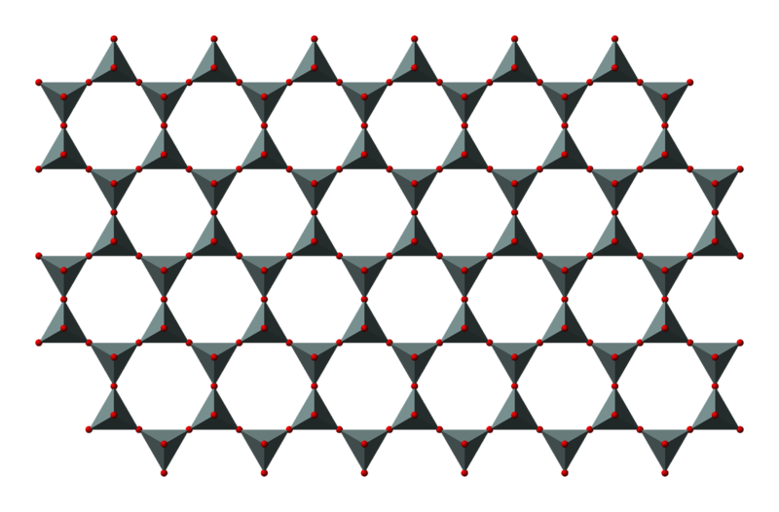
Sheet silicates
In this group tetrahedra all share three oxygen atoms each and in turn link to form two-dimensional sheets. This structure does lead to minerals in this group having one strong cleavage plane. Micas fall into this group. Both muscovite and biotite have very weak layers that can be peeled off in sheets.

Slide 27
Framework silicates
In a framework silicate, each tetrahedron shares all 4 oxygen atoms with its neighbors, forming a 3D-4D structure. Quartz and feldspars are in this group.

Slide 28
Physical Properties: Eruption Temperature
Large range in eruption temperatures:
  Komatiites (ultramafic lava): ~1400-1600°C
  Basalts: e.g., Hawaiian basalt ~1200°C
  Rhyolite: < 800°C
  Carbonatites: down to <500° C
Eruption temperatures relate to composition:
  Mg-rich magma is hot
  Si-rich magma is cold
Eruption temperatures also strongly affect viscosity

Slide 29
Types of Magma
Chemical composition of magma is controlled by the abundance of elements in the Earth. Si, Al, Fe, Ca, Mg, K, Na, H, and O make up 99.9%. Since oxygen is so abundant, chemical analyses are usually given in terms of oxides. SiO₂ is the most abundant oxide.
1. Mafic or Basaltic-- SiO₂ 45-55 wt%, high in Fe, Mg, Ca, low in K, Na
2. Intermediate or Andesitic-- SiO₂ 55-65 wt%, intermediate. in Fe, Mg, Ca, Na, K
3. Felsic or Rhyolitic-- SiO₂ 65-75%, low in Fe, Mg, Ca, high in K, Na.

Slide 30
Gases - At depth in the Earth nearly all magmas contain gas. Gas gives magmas their explosive character, because the gas expands as pressure is reduced.
Mostly H₂O with some CO₂
Minor amounts of Sulfur, Cl , and F
Felsic magmas usually have higher gas contents than mafic magmas.
Temperature of Magmas
Mafic/Basaltic - 1000-1200º C
Intermediate/Andesitic - 800-1000º C
Felsic/Rhyolitic - 650-800º C.

Slide 31
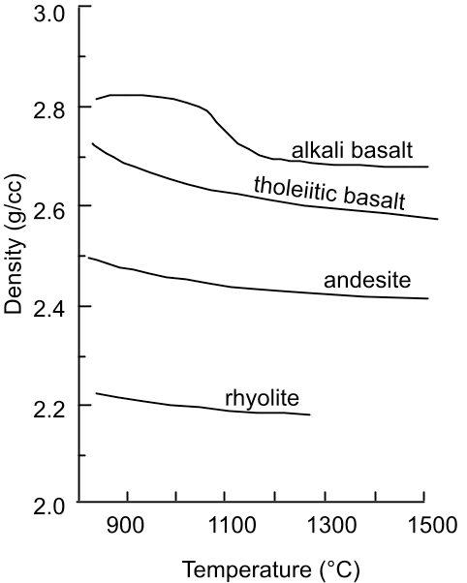
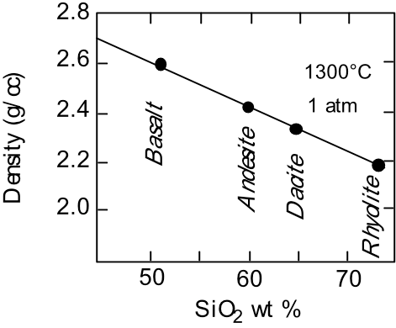
Density
Determines buoyancy & crystal settling
Depends on composition and temperature
As silicic magma evolve it’s density will normally decreased due to increasing of silica content and settling of all heavy minerals which concentrated in the early stages of crystallization into rocks which formed at high temperatures, so in case of silicic magma by decreasing it’s density, it will be more polymerized.

Slide 32
Viscosity
Perhaps the most important physical property for volcanology
Definition: viscosity is the internal resistance to flow
Viscosity of Magmas
Viscosity is the resistance to flow (opposite of fluidity). Depends on composition, temperature, & gas content.
Higher SiO₂ content magmas have higher viscosity than lower SiO₂ content magmas
Lower Temperature magmas have higher viscosity than higher temperature magmas.

Slide 34
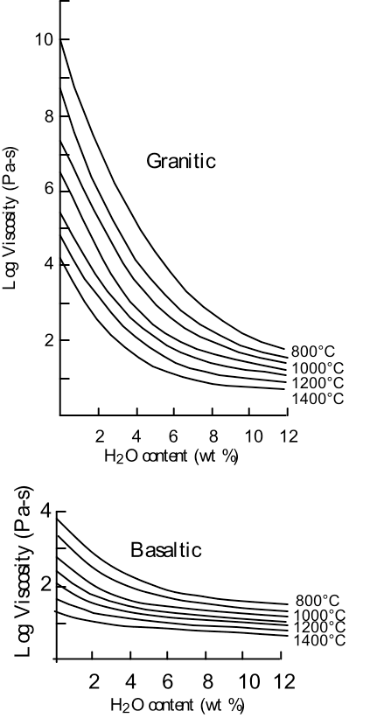
Effect of water on viscosity
Hydrogen in melts is largely present as OH–
Hydrogen ion binds to oxygens of the tetrahedra
  Oxygens bound to H cannot be shared
Hence addition of hydrogen or water reduces the polymerization of the melt.
Polymerization is a process by which molecules increase in size by the repeated addition of smaller molecules. Silicate magmas are polymerized liquids consisting of a network of SiO4 tetrahedra units linked by sharing oxygen atoms with neighboring tetrahedra.
Water dramatically reduces viscosity, particularly of polymerized melts

Slide 35
Polymerization affected by water content into magma:
Water decreases polymerization by reacting with bridging oxygen to form non-bridging oxygen and hydroxyl molecules.
The solubility of water in silica-rich magmas is, therefore, much higher than silica-poor due to high degree of polymerization. Water decreases the viscosity of magmas by decreasing the degree of polymerization.

Slide 38
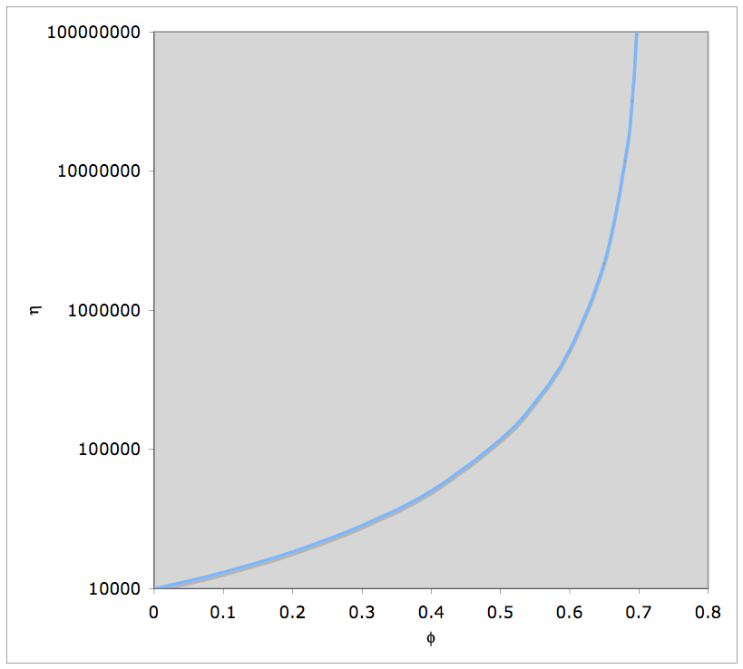
Effect of Crystals on Viscosity
Effect of crystallization on viscosity
Effect of crystals (and bubbles)
  Increase viscosity

Slide 39
Carbonatites: the exceptions
Carbonatite magmas
are solutions of mainly carbonate (CO₃) minerals rather than silicates.
Can erupt at surprisingly low temperature (400- 500°C)
Very low viscosity (1 Pa-s and lower).
Note that Pa-s stands for a pascal-second which is measurement unit of dynamic viscosity

Slide 40
Gases in Magmas
Principal Magmatic Gases:
  H₂O
  CO₂
  S (may be present as S ion, H₂S, or SO₂)
  F
  Cl
Estimate gas concentrations in Kilauea
H₂O | CO₂ | S | Cl | F
0.30% | 0.65% | 0.13% | 0.009% | 0.035%

Slide 41
Gases in Dacite
Total of 4.6% dissolved gas
  60-70% of this was H₂O
In island-arc or subduction-related magmas, H₂O is usually the dominant gas
  These volcanoes also tend to be gas rich.
In MORB (mid-ocean ridge basalts) and OIB (oceanic island basalts) CO₂ and H₂O concentrations may be roughly similar and are quite low (<0.5%)

Slide 42
Physical Changes in Magma as it Ascends
Temperature Drops
  Increase in viscosity
  Crystallization begins
    Increase in viscosity
    Composition becomes more silicic (more polymerized)
      Increase in viscosity
    Gases concentrated in melt
Pressure Drops
  Gases exsolve
    H₂O concentration drops
      Increase in viscosity
    Bubbles form
      Increase in viscosity

Slide 43
Gases in Magmas
At depth in the Earth nearly all magmas contain gas dissolved in the liquid, but the gas forms a separate vapor phase when pressure is decreased as magma rises toward the surface of the Earth.
This is similar to carbonated beverages which are bottled at high pressure. The high
pressure keeps the gas in solution in the liquid, but when pressure is decreased, like when you open the can or bottle, the gas comes out of solution and forms a separate gas phase that you see as bubbles.
Gas gives magmas their explosive character, because volume of gas expands as pressure is reduced. The composition of the gases in magma are:
Mostly H2O (water vapor) & some CO2 (carbon dioxide)
Minor amounts of Sulfur, Chlorine, and Fluorine gases

Slide 44
The amount of gas in a magma is also related to the chemical composition of the magma.
Rhyolitic magmas usually have higher gas contents than basaltic magmas (Guess!! Why?).

Slide 45
Viscosity of Magmas
Viscosity is the resistance to flow (opposite of fluidity). Viscosity depends on primarily on the composition of the magma, and temperature.
* Higher SiO2 (silica) content magmas have higher viscosity than lower SiO2 content (Why?!!!)
magmas (viscosity increases with increasing SiO2 concentration in the magma).
* Lower temperature magmas have higher viscosity than higher temp

Slide 46
Thus, basaltic magmas tend to be fairly fluid (low viscosity), but their viscosity is still 10,000 to 100,0000 times more viscous than water.
*Rhyolitic magmas tend to have even higher viscosity, ranging between 1 million and 100 million times more viscous than water.
Viscosity is an important property in determining the eruptive behavior of magmas.

Slide 47
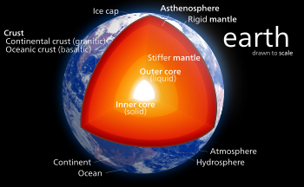
How Magmas Form in the Earth
As we have seen the only part of the earth that is liquid is the outer core. But the core is not likely to be the source of magmas because it does not have the right chemical composition.
The outer core is mostly Iron, but magmas are silicate liquids.
Thus, magmas DO NOT COME FROM THE MOLTEN OUTER CORE OF THE EARTH.
Since the rest of the earth is solid, in order for magmas to form, some part of the earth must get hot enough to melt the rocks present.

Slide 48
We know that temperature increases with depth in the earth along the geothermal gradient.
The earth is hot inside due to heat left over from the original accretion process, due to heat released by sinking of materials to form the core, and due to heat released by the decay of radioactive elements in the earth.
Under normal conditions, the geothermal gradient is not high enough to melt rocks, and thus with the exception of the outer core, most of the Earth is solid. Thus, magmas form only under special circumstances, and thus, volcanoes are only found on the Earth's surface in areas above where these special circumstances occur.
To understand this we must first look at how rocks and mineral melt.
As pressure increases in the Earth, the melting temperature changes as well. For pure minerals, there are two general cases.

Slide 49
Different minerals, when together in the same rock, melt at much lower temperatures than individual minerals.
For example, in the Bowen reaction series, quartz is crystallizing around 650°C, but pure quartz at one atmosphere pressure does not melt until about 1700°C. (1670°C for β-tridymite and 1713°C for β-cristobalite).
It is impossible to determine melting temps for micas, amphiboles and any other mineral that contains water - because hydrous minerals break down via dehydration reactions before they melt.
And, we really cannot determine melting temperatures for minerals like quartz and Kspar because they change into different minerals when heated, before they melt, even though they do not contain water. (Melting temps for these minerals listed in tables are really the melting temps of high-temperature polymorphs.)

Slide 50
The type of melt depends on if water is present. water highers melting temperature causing rocks to melt further down, then crystalize before reaching surface. Dry melts are opposite.
If the mineral contains no water (H₂O) or carbon dioxide (CO₂) and there is no water or carbon dioxide present in the surroundings, then melting occurs at a single temperature at any given pressure and melting temperature increases with increasing pressure or depth in the Earth. This is called dry melting.

Slide 51
If water or carbon dioxide are present within or surrounding the mineral, then melting takes place at a single temperature at any given pressure, but first decreases with increasing
pressure

Slide 52
Since rocks are mixtures of minerals, they behave somewhat differently. Unlike minerals, rocks do not melt at a single temperature, but instead melt over a range of temperatures. Thus, it is possible to have partial melts, from which the liquid portion might be extracted to form magma. The two general cases are:
1. Melting of dry rocks is similar to
melting of dry minerals, melting
temperatures increase with increasing
pressure, except there is a range of
temperature over which there exists a
partial melt. The degree of partial
melting can range from 0 to 100%.

Slide 53
2. Melting of wet rocks is similar to
melting of wet minerals, except there
is range of temperature range over
which partial melting occurs. Again,
the temperature of beginning of
melting first decreases with
increasing pressure or depth, then at
high pressure or depth the melting
temperatures again begin to rise.

Slide 54
Basaltic Magma
Basaltic magma is formed through dry partial melting of the mantle. The mantle lies just below the crust of the earth. Basalts make up most of the ocean’s crust; this is why basaltic magma is typically found in oceanic volcanoes. In order for the mantle to partially melt, the geothermal gradient, or the change in the Earth’s temperature based on internal pressure or depth, must be changed by some sort of mechanism, such as convection.
With convection, hot mantle material rises closer to the Earth’s surface, raising the geothermal gradient in the area. This causes the temperature in the earth’s mantle to rise, which causes the mantle to partially melt. The partial melt contains both liquid and crystals that need a higher temperature to melt. The liquid can be separated from the crystals, forming basaltic magma.

Slide 55
Rhyolitic Magma
Rhyolitic magma forms as a result of wet melting of continental crust. Rhyolites are rocks that contain water and minerals that contain water, such as biotite. The continental crust must be heated above the normal geothermal gradient in order to melt. The most common cause of a rise in temperature of continental crust is basaltic magma rising from the mantle.
Basaltic magma is usually very dense and gets stopped in the continental crust rather than reaching the surface, causing it to crystallize. This crystallization releases the basaltic magma’s heat, causing the temperature of the continental crust to rise and melt.

Slide 56
Andesitic Magma
Andesitic magma is formed through wet partial melting of the mantle. The mantle under the ocean has contact with water. When subduction, or continental plates pulling away from one another, occurs, the mantle will heat up and water is pushed into it. This causes the melting temperature of the mantle to decrease, causing the mantle to begin partially melting due to the heat. Basaltic magma with a high water content is the result. If this type of basaltic magma melts with continental crust that has a high density of dioxide silicon, andesitic magma will form.

Slide 57
How Does Magma Form?
The temperature of the Earth increases from crust to core at approximately 30 C/km (this is called the geothermal gradient). The core temperature is > 5000 C, and heat moves upward from the very hot core (where temperatures exceed 5000°C) and melts the upper mantle and crust.
Melting can also result from a decrease in pressure. Since pressure favors solids, mineral melting points decrease with decreasing pressure. This decompression melting occurs when hot mantle rock moves upward.
The presence of water vapor reduces the melting point of rock. Wet magma (magma with water vapor) melts at a lower temperature than dry magma (magma with no water vapor). For example, wet granite melts at 700°C whereas dry granite melts at 900°C.
Mixtures of minerals always have lower melting points than the pure minerals would. For example, plagioclase melts at ~1650°C and K-Feldspar melts at ~1300°C. However, a 50/50 mixture of these two minerals will melt at ~1150°C.

Slide 58
The Link Between Igneous Activity and Plate Tectonics
Igneous activity occurs mainly at or near tectonic plate boundaries.
Mafic igneous rocks commonly form at divergent boundaries. Here, the low overburden pressure (decompression) contributes to the formation of mafic magmas formed by partial melting of the asthenosphere (upper mantle).
Intermediate igneous rocks commonly form at convergent boundaries. Partial melting of subducted asthenosphere produces basaltic magma which evolves into intermediate magma by differentiation, assimilation, and magma mixing.
Felsic igneous rocks are also common adjacent to convergent boundaries. Hot mafic magmas produced near the subducting slab may induce partial melting and assimilation of continental (granitic) crust.
Some igneous rocks form within plates (not at a plate boundary). Rising mantle plumes (of controversial origin) can produce localized hotspots and volcanoes as they rise through continental or oceanic crust.

Slide 59
Chemical Composition of Magmas
The chemical composition of magma can vary depending on the rock that initially melts (the source rock), and process that occur during partial melting and transport.
Initial Composition of Magma
The initial composition of the magma is dictated by the composition of the source rock and the degree of partial melting. In general, melting of a mantle source (garnet peridotite) results in mafic/basaltic magmas. Melting of crustal sources yields more siliceous magmas.
In general more siliceous magmas form by low degrees of partial melting. As the degree of partial melting increases, less siliceous compositions can be generated. So, melting a mafic source thus yields a felsic or intermediate magma. Melting of ultramafic (peridotite source) yields a basaltic magma.

Slide 60
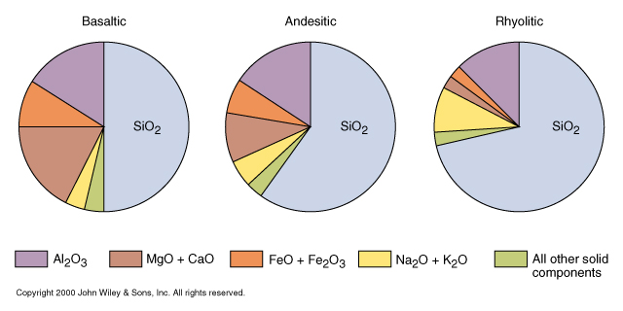
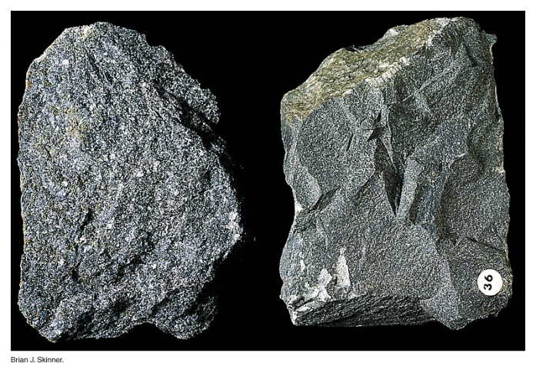
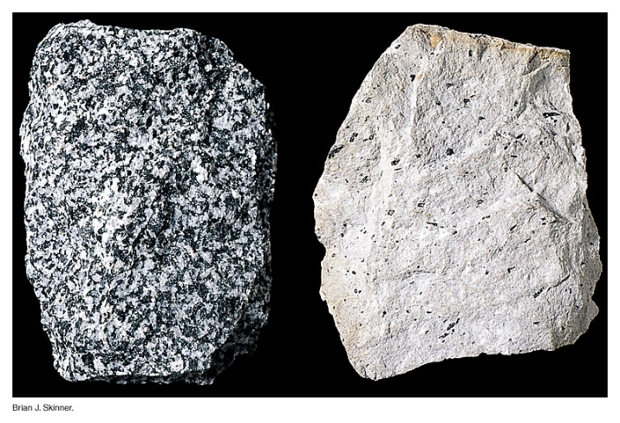
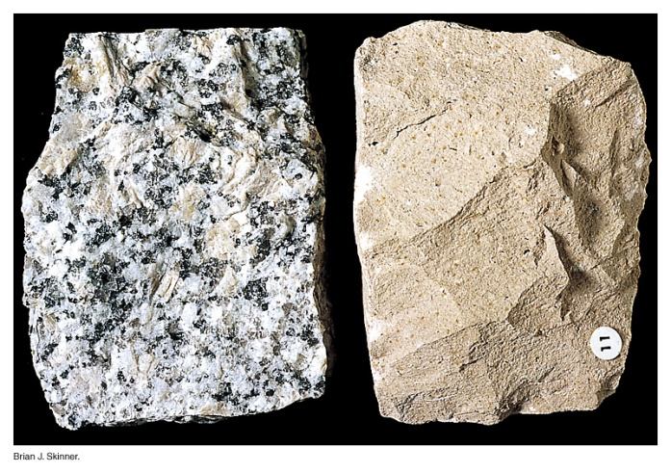
Magma Types Based on Chemistry
50% SiO₂
60% SiO₂
70% SiO₂
gabbro/basalt
diorite/andesite
granite/rhyolite

Slide 61
Magmatic Differentiation
But, processes that operate during transportation toward the surface or during storage in the crust can alter the chemical composition of the magma. These processes are referred to as magmatic differentiation and include assimilation, mixing, and fractional crystallization.
Assimilation - As magma passes through cooler rock on its way to the surface it may partially melt the surrounding rock and incorporate this melt into the magma. Because small amounts of partial melting result in siliceous liquid compositions, addition of this melt to the magma will make it more siliceous.

Slide 62
Mixing - If two magmas with different compositions happen to come in contact with one another, they could mix together. The mixed magma will have a composition somewhere between that of the original two magma compositions. Evidence for mixing is often preserved in the resulting rocks.
Crystal Fractionation - When magma solidifies to form a rock it does so over a range of temperature. Each mineral begins to crystallize at a different temperature, and if these minerals are somehow removed from the liquid, the liquid composition will change. Depending on how many minerals are lost in this fashion, a wide range of compositions can be made. The processes is called magmatic differentiation by crystal fractionation.

Slide 63
Crystals can be removed by a variety of processes. If the crystals are more dense than the liquid, they may sink. If they are less dense than the liquid they will float. If liquid is squeezed out by pressure, then crystals will be left behind. Removal of crystals can thus change the composition of the liquid portion of the magma. Let us illustrate this using a very simple case.

Slide 64
Imagine a liquid containing 5 molecules of MgO and 5 molecules of SiO2. Initially the composition of this magma is expressed as 50% SiO2 and 50% MgO
Now let's imagine I remove 1 MgO molecule by putting it into a crystal and removing the crystal from the magma. Now what are the percentages of each molecule in the liquid?
If we continue the process one more time by removing one more MgO molecule.

Slide 65
Thus, composition of liquid can be changed. This process is called crystal fractionation. A mechanism by which a basaltic magma beneath a volcano could change to andesitic magma and eventually to rhyolitic magma through crystal fractionation, is provided by Bowen's reaction series, discussed next.

Slide 66
Magma Types Based on Chemistry
50% SiO₂
60% SiO₂
70% SiO₂
gabbro/basalt
diorite/andesite
granite/rhyolite

Slide 67
Processes That Change Magma Compositions
Primary Process ⇒
Partial Melting of Different Materials (e.g. mantle, oceanic crust, continental crust, etc.)
Secondary Processes - “Magmatic Differentiation”
Fractional Crystallization
Assimilation/Magma Mixing
Combined Process (AFC)

Slide 68
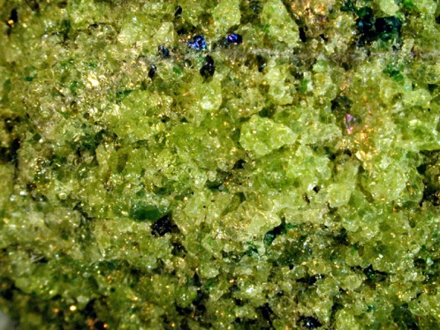
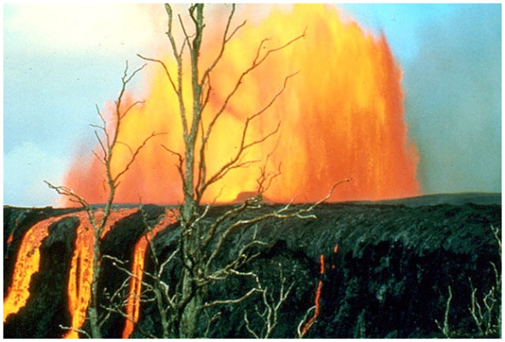
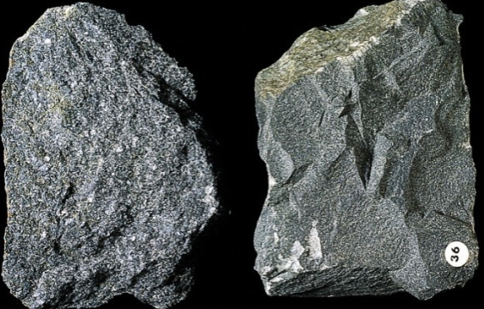
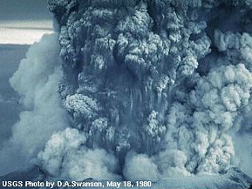
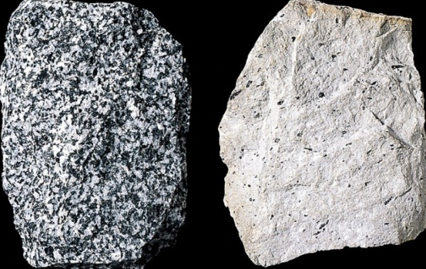
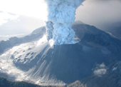
Partial Melting of Different Starting Materials
Peridotite (mantle rock) ⇒ Basaltic Magma
Basaltic (oceanic crust) ⇒ Andesitic Magma
Andesitic (continental crust) ⇒ Rhyolitic Magma

Slide 69
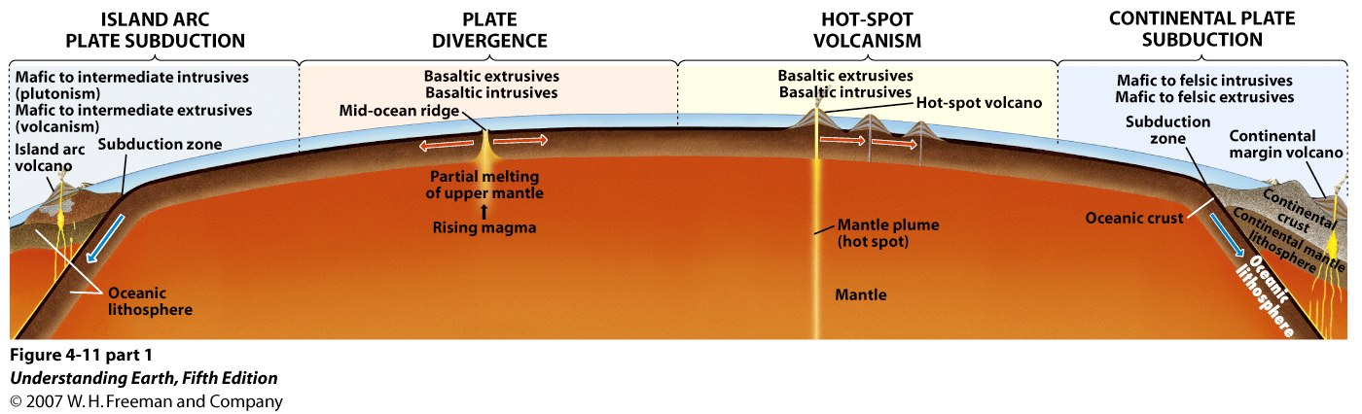
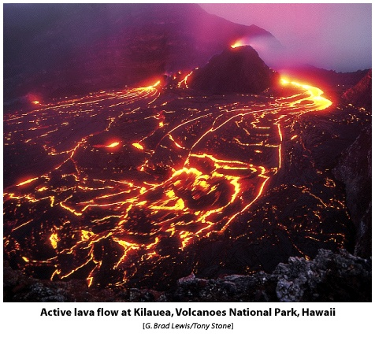
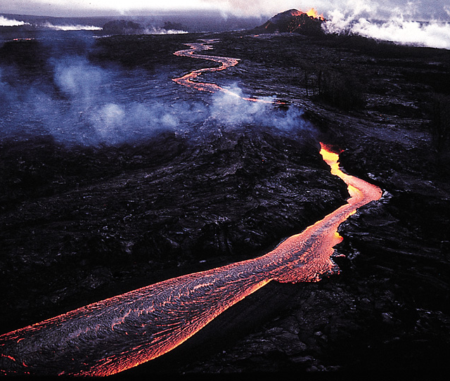
Mantle Melting and the Origin of Basaltic Magma
Notes:
Seismic evidence −> basalts are generated in the mantle
Partial melting of mantle material
Probably can derive most other magmas from this primary magma by fractional crystallization, assimilation, etc. Basalt is the most common magma
If we are going to understand the origin of igneous rocks, it’s best to start with the generation of basalt from the mantle

Slide 70
Primary Basaltic Magmas
Mantle melts with no subsequent modification by secondary processes (fractional crystallization, assimilation, mixing).
Criteria:
    MgO = 11 – 17 wt%
    Cr > 1000 ppm
    Ni > 400-500 ppm
Rarely observed, “Holy Grail” of basalts, very important for petrologists and geochemists, fingerprint of mantle source!

Slide 71
Processes That Change Magma Compositions
Primary Process ⇒
Partial Melting of Different Materials (e.g. mantle, oceanic crust, continental crust, etc.)
Secondary Processes - “Magmatic Differentiation”
Fractional Crystallization
Assimilation/Magma Mixing
Combined Process (AFC = Assimilation + Fractional Crystallization)

Slide 72
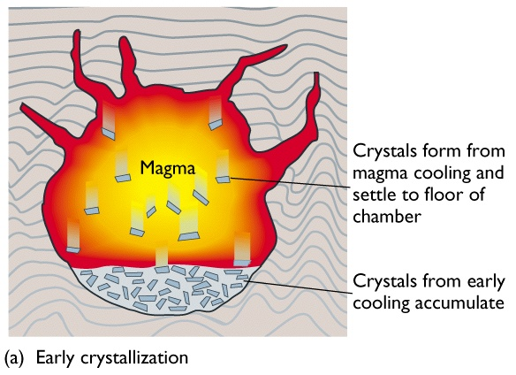
Fractional Crystallization
magma composition progressively changes as crystals are physically “removed” from the magma.

Slide 73
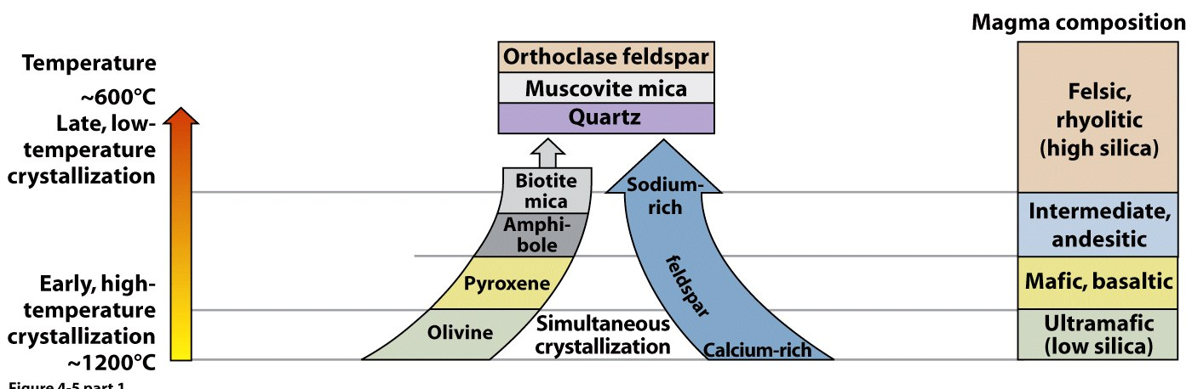
Bowen’s Reaction Series
Theoretical order in which common igneous crystallize, and generally speaking correct!
Used in early 1900’s (by N.L. Bowen) to explain the origin of granite from primary basaltic magmas. True only in rare cases.

Slide 74
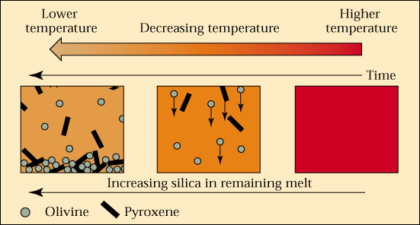
Fractional Crystallization
Remaining Magma is Andesitic
Basaltic Magma

Slide 75
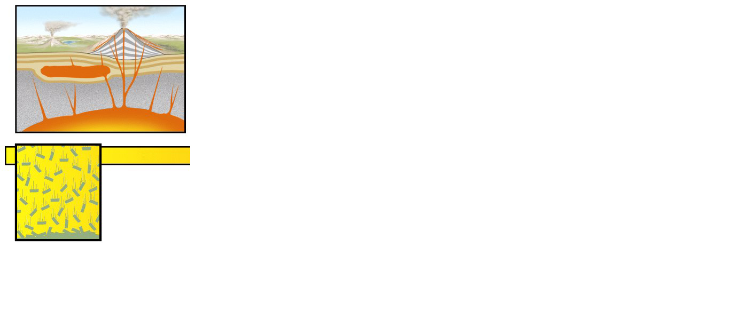
intrusion
~1200°C
Olivine
crystals
Magma with
composition A
Olivine crystallizes
first.

Slide 76
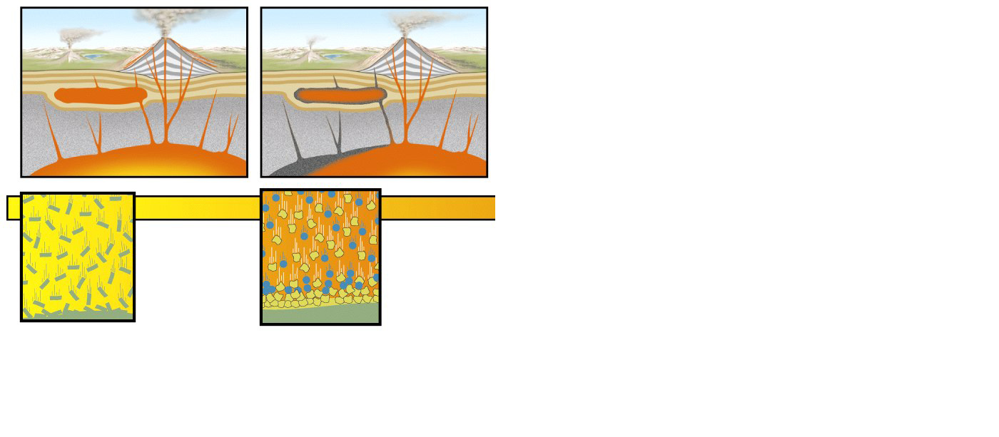
Palisades
intrusion
~1200°C
~1100°C
Olivine
crystals
Plagioclase
feldspar
Pyroxene
Olivine
Magma with
composition A
Magma with
composition B
Olivine crystallizes
first.
Pyroxene and plagioclase
feldspar
crystallize.

Slide 77
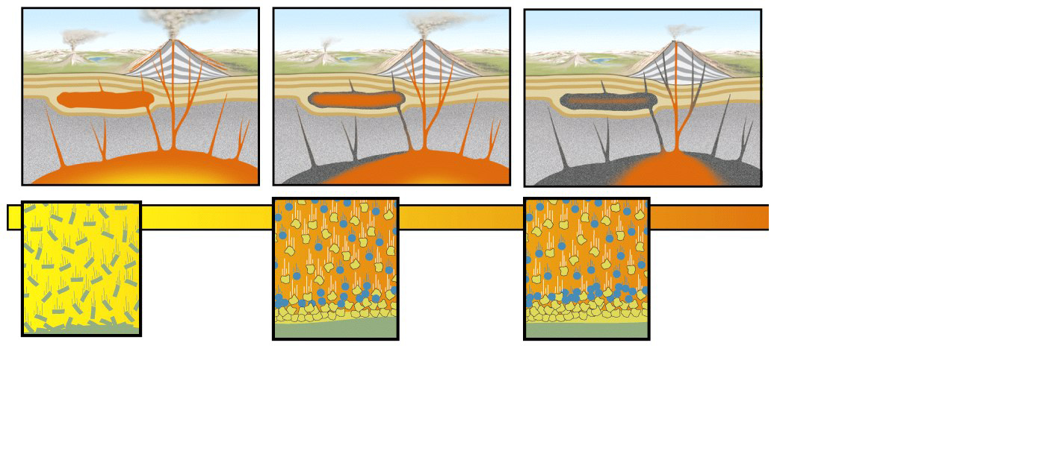
Palisades
intrusion
~1200°C
~1100°C
~1050°C
Olivine
crystals
Plagioclase
feldspar
Plagioclase
feldspar
Pyroxene
Pyroxene
Olivine
Olivine
Magma with
composition A
Magma with
composition B
Magma with
composition C
Olivine crystallizes
first.
Pyroxene and plagioclase
feldspar
crystallize.
Pyroxene and
plagioclase gradually change in composition.

Slide 78
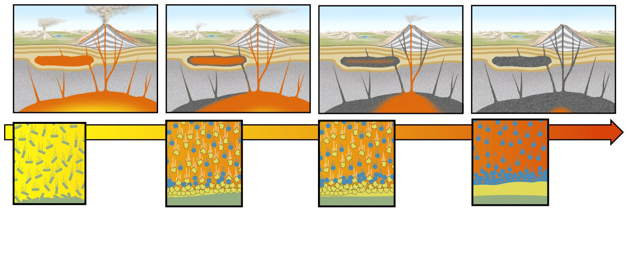
Palisades
intrusion
~1200°C
~1100°C
~1050°C
~1000°C
Olivine
crystals
Plagioclase
feldspar
Plagioclase
feldspar
Plagioclase
feldspar
Pyroxene
Pyroxene
Pyx+Plag
Olivine
Olivine
Olivine
Magma with
composition A
Magma with
composition B
Magma with
composition C
Magma with
composition D
Olivine crystallizes
first.
Pyroxene and plagioclase
feldspar
crystallize.
Pyroxene and
plagioclase gradually change in composition.
Plagioclase feldspar continues to crystallize.

Slide 79
Processes That Change Magma Compositions
Primary Process ⇒
Partial Melting of Different Materials (e.g. mantle, oceanic crust, continental crust, etc.)
Secondary Processes - “Magmatic Differentiation”
Fractional Crystallization
Assimilation/Magma Mixing
Combined Process (AFC = Assimilation + Fractional Crystallization)

Slide 80
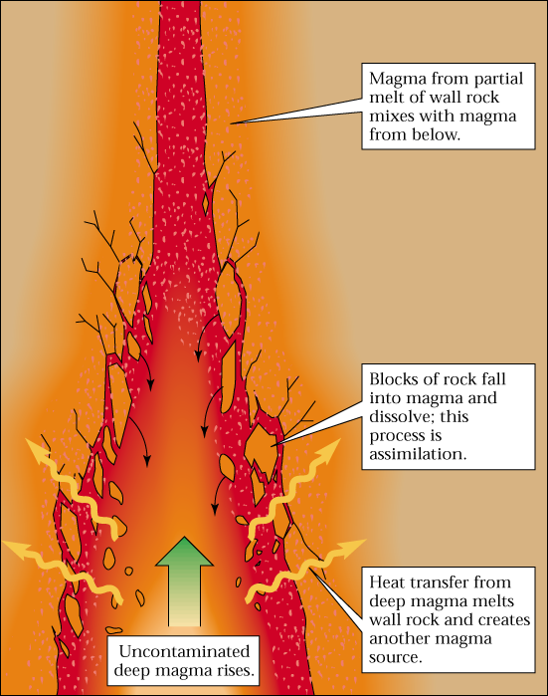
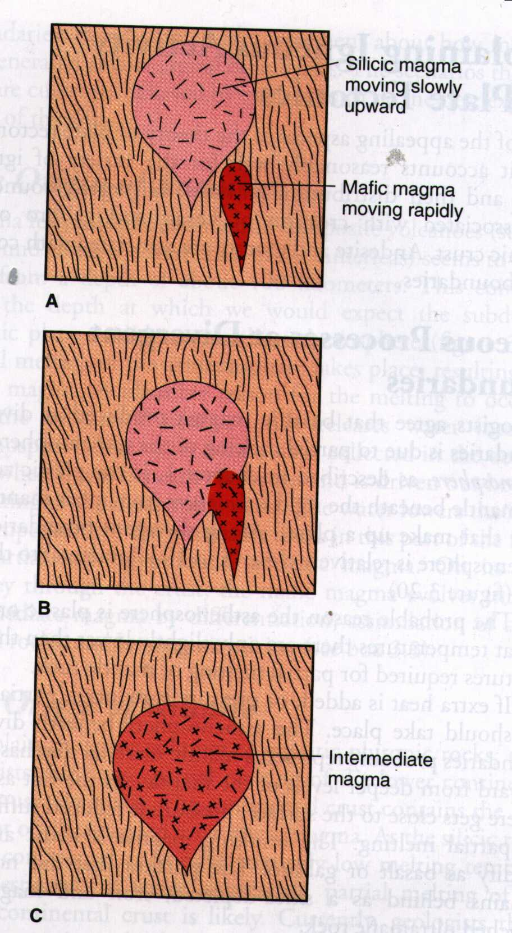
Assimilation
Magma Mixing
Basaltic magma
Rhyolitic magma
Continental Crust
Basaltic
+
Rhyolitic
Blocks of continental crust fall into basaltic magma and dissolve.
basaltic magma + assimilated blocks = andesitic magma
Andesitic magma
Heat transfer from hot, basaltic magma melts wall rock
HOT (1200°C) basaltic magma

Slide 81
Assimilation + Fractional Crystallization (AFC)
Continental Crust
Blocks of continental crust fall into basaltic magma and dissolve.
basaltic magma + assimilated blocks = andesitic magma
magma composition progressively changes as crystal are physically “removed” from the magma
Heat transfer from hot, basaltic magma melts wall rock
HOT (1200°C) basaltic magma

Slide 82
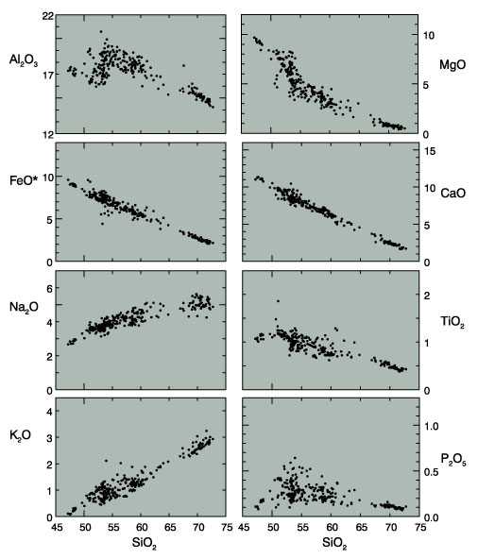
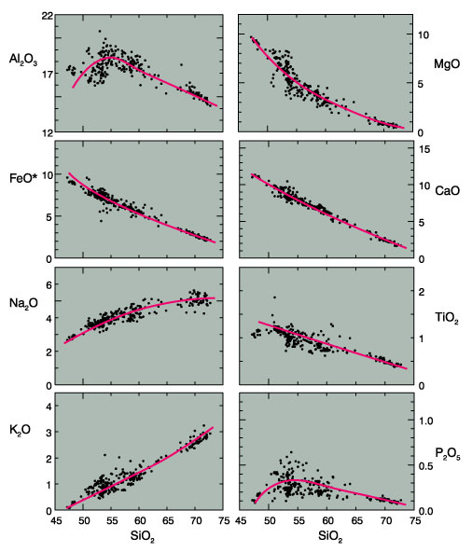
Harker Diagrams
Trends usually indicate that rocks are “related” by some petrogenetic process (ie. crystal fractionation, mixing, or AFC)
basalt
andesite
rhyolite
basalt
andesite
rhyolite
basalt
andesite
rhyolite
basalt
andesite
rhyolite
= Parental magma
= differentiation trend
Notes:
Based on compiled data by Rick Conrey (unpub)

Slide 83
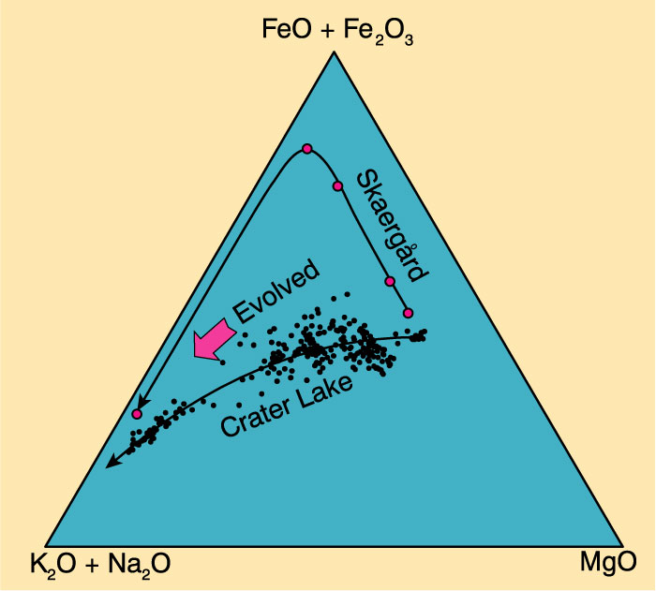
AFM Diagram
basalt
andesite
rhyolite
basalt
andesite
rhyolite
basalt
andesite
rhyolite
basalt
andesite
rhyolite
andesite
basalt
rhyolite
= Parental magma
= differentiation trend
Notes:
Based on compiled data by Rick Conrey (unpub)

Slide 84
Igneous rock series
Is a group of igneous rocks that are genetically related (co-magmatic) and which were collected from a relatively small area (an igneous province). Rocks of an igneous rock series therefore display a continuous gradation in chemical composition from the most basic to the most acidic in the group.
A parental magma: Is a magma capable of producing all rocks belonging to an igneous rock series by differentiation (In geology, igneous differentiation is an umbrella term for the various processes by which magmas undergo bulk chemical change during the partial melting process, cooling, emplacement, or eruption.)

Slide 85
A primary magma: Is the "first melt" produced by partial melting within the mantle, and which has not yet undergone any differentiation.
A primary magma may therefore evolve into a parental magma by differentiation. For a melt to qualify for the definition of primary magma, it must fulfill the following conditions:
(1) have a higher liquidus T compared to its differentiation products,
(2) be richer in minerals removed by fractional crystallization compared to its differentiation products,
(3) have a composition in equilibrium with the mantle phases from which it was produced by partial melting at high pressure. All primary magmas must have > 10% MgO by weight.

Slide 86
When a rock melts to form a liquid, the liquid is known as a primary melt. Primary melts have not undergone any differentiation and represent the starting composition of a magma. In nature, primary melts are rarely seen. Some leucosomes of migmatites are examples of primary melts. Primary melts derived from the mantle are especially important and are known as primitive melts or primitive magmas. By finding the primitive magma composition of a magma series, it is possible to model the composition of the rock from which a melt was formed, which is important because we have little direct evidence of the Earth's mantle

Slide 87
Types of primary magmas
Unlike parental magmas, primary magmas, which are ones produced by partial melting in the mantle, and which have not differentiated, can only be of two types: basic or ultrabasic. Basic primary magmas are simply basaltic, which by definition, have to yield Cpx + Plag upon crystallization. However, not all basalts are the same.
Basalts and their types:
Yoder and Tilley (1962) classified basalts into four different types based on their normative minerals. Although this is a chemical classification, the norms of many basalts (especially those which are totally crystalline and almost devoid of phenocrysts) come very close to their modes. This classification, which also applies to basaltic magmas.
1) quartz tholeiitic
2) olivine tholeiitic
3) alkali olivine basaltic (AOB)

Slide 88
If we were to consider the feldspathoidal magmas as well, we can define a fourth type of “basaltic” magma: "basanitic".
The characteristics of rocks resulting from the wholesale crystallization of these magmas are summarized in the table:
A fifth type of basalt which is not part of Yoder and Tilley's (1962) classification but is nonetheless recognized is the high Al₂O₃ basalt considered in many cases as the parental magma for many calc-alkaline rocks. These basalts are phenocryst - poor and are characterized by Al₂O₃ contents > 17 weight %.
Series | Norm | Mode
Qz-tholeiite | qz + hy | Hy
Ol-tholeiite | hy + ol | Hy and/or Ol
AOB | ol ± ne | Ol
Basanite | ol + ne | Ol + Ne

Slide 89
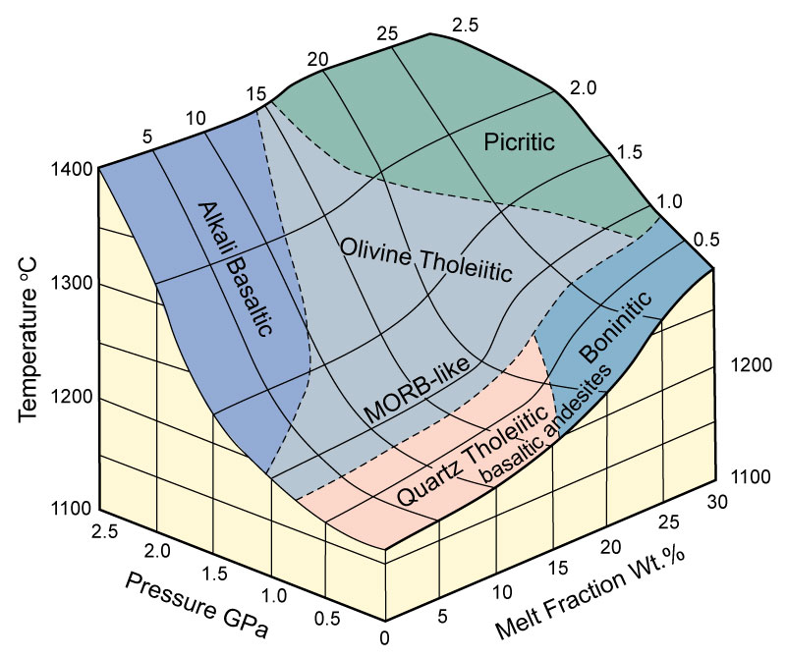

Slide 90
2) Ultrabasic primary magmas:
The only other possible type of primary magma has to be ultrabasic (given the composition of the mantle). In order to assess the importance of ultrabasic magmas, we must examine the different types of ultrabasic volcanic rocks and their abundance.
Nephelinite: Is a volcanic rock with normative ol + lots of ne, and modal Ti-augite, Ol, feldspathoids ± phlogopite ± perovskite (CaTiO₃)± melilite (Ca,Na)2(Al,Mg,Fe²⁺)[(Al,Si)SiO₇ in addition to matrix alkali feldspar.
b) Komatiite: Is a volcanic rock consisting almost entirely of Ol + augite + hypersthene ± plagioclase, and characterized by a “spinifex” texture which indicates quenching. These rocks are very rare, and are almost restricted to Archean terranes.

Slide 91
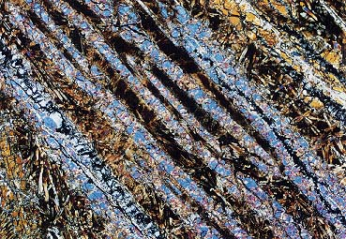
Komatiite
olivine
rare ultramafic volcanic rocks(>18 wt.% MgO ).
Komatiite sample displays "spinifex texture" defined by extremely acicular olivine phenocrysts (blue colored )--probably a sign of rapid crystallization from a significantly-undercooled magma.

Slide 92
c) Kimberlite: Is a porphyritic rock that contains phlogopite + olivine phenocrysts in a matrix of phlogopite + olivine + serpentine + calcite + apatite + ilmenite + perovskite. Kimberlites are rare as lava flows, more commonly occurring in "diatremes" or pipes. Kimberlites often contain inclusions or xenoliths of eclogite, and may be diamond - bearing.
d) Carbonatite: Is a volcanic or intrusive rock that consists predominantly of calcite + dolomite + ankerite ± pyroxenes ± olivine ± a variety of accessory minerals many of which contain rare earth elements.

Slide 93
It can be seen from this brief introduction that basalts are more common than the ultrabasic lavas. Nevertheless, the origin of these different rock types will be discussed later.

Slide 94
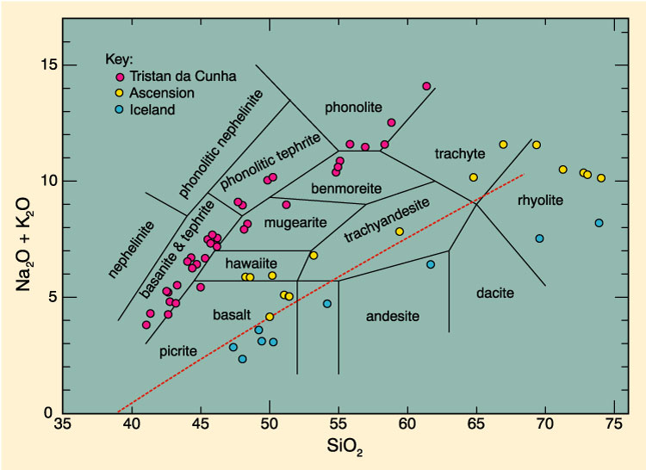
Evolution in the Series
Tholeiitic, alkaline, and highly alkaline

Slide 95
Chemical composition of igneous rocks is the most distinguishing feature.
The composition usually reflects the composition of the magma, and thus provides information on the source of the rock.
The chemical composition of the magma determines the minerals that will crystallize and their proportions.
A set of hypothetical minerals that could crystallize from a magma with the same chemical composition as the rock (called the Norm), can facilitate comparison between rocks.

Slide 97
Chemical analyses can be obtained, and a chemical classification, such as the Le Bas et al., 1962, IUGS chemical classification of volcanic rocks (based on total alkalies [Na₂O + K₂O] vs. SiO₂ diagram shown below)

Slide 98
Chemical & Mineralogical Classification of
Magmas
Chemical makeup of magmas - 11 major oxides:
SiO2, Al2O3, FeO, MgO, CaO, Na2O, K2O, TiO2, MnO, P2O5, Fe2O3
SiO2 is always most abundant, whether a basalt or a rhyolite
These same elements join to form a select few minerals: -clinopyroxene, orthopyroxene, olivine, amphibole, mica, quartz, plagioclase, alkali feldspar, feldspathoid, oxides (magnetite/ilmenite/chromite)

Slide 99
Classification of igneous rocks can both be dependent on the
mineralogy (modal classification) or the oxide chemistry (includes normative calculation)
mode = mineralogical composition of rock - volume %
norm = calculated mineralogical composition based on conversion of chemical analysis into the formulas of minerals.
Ideal situation: norm = mode (but hardly ever happens)

Slide 100
Degree of silica saturation in norm
Oversaturated - In norm: quartz present, no feldspathoids, hypersthene present
Saturated - In norm: no quartz or feldspathoids, but hypersthene present
Undersaturated - In norm: no quartz or hypersthene, but feldspathoids present

Slide 101
Silica Saturation
If a magma is oversaturated with respect to Silica then a silica mineral, such as quartz, cristobalite, tridymite, or coesite, should precipitate from the magma, and be present in the rock. On the other hand, if a magma is undersaturated with respect to silica, then a silica mineral should not precipitate from the magma, and thus should not be present in the rock. The silica saturation concept can thus be used to divide rocks in silica undersaturated, silica saturated, and silica oversaturated rocks. The first and last of these terms are most easily seen.
Silica Undersaturated Rocks
In these rocks we should find minerals that, in general, do not occur with quartz. Such minerals are:

Slide 102
Silica Oversaturated Rocks.
These rocks can be identified as possibly any rock that does not contain one of the minerals in the above list.
If we calculate a CIPW Norm, silica oversaturated rocks will contain normative quartz.
Silica Saturated Rocks.
These are rocks that contain just enough silica that quartz does not appear, and just enough silica that one of the silica undersaturated minerals does not appear.
In the CIPW norm, these rocks contain olivine, or hypersthene + olivine, but no
quartz, no nepheline, and no leucite

Slide 103
Note how compositions between Fo and En will end their crystallization with only Fo olivine and enstatite.
These are SiO₂ undersaturated.
All compositions between En and SiO₂ will end their crystallization with quartz and enstatite. These are SiO₂ oversaturated compositions.
Note also that this can cause some confusion in volcanic rocks that do not complete their crystallization due to rapid cooling on the surface.
Let's imagine first a composition in the silica-undersaturated field. Cooling to anywhere on the liquidus will result in the crystallization of Fo rich olivine. If this liquid containing olivine is erupted and the rest of the liquid quenches to a glass, then this will produce a rock with phenocrysts of olivine in a glassy groundmass.
Applying the criteria above for identifying silica undersaturated rocks would tell us that this is a silica-undersaturated rock, which we know to be correct.

Slide 104
Degree of alumina saturation in norm
Peraluminous (= alumina oversaturated): Al2O3 > K2O + Na2O + CaO
Corundum in norm
Metaluminous (= alumina saturated): K2O + Na2O + CaO > Al2O3 > Na2O + K2O
Anorthite and diopside in norm
Peralkaline (= alumina undersaturated): K2O + Na2O > Al2O3
Acmite in norm (NaFeSi2O6)

Slide 105
Comparison of normative and modal mineralogy in peraluminous,
metaluminous, and peralkaline rocks

Slide 106
Comparing silica and alumina saturations:
Never get peraluminous rocks silica undersaturated
Metaluminous rocks are either silica saturated or oversaturated
Peralkaline can be any saturation of silica, but saturated or undersaturated most common

Slide 107
Alumina (Al2O3) Saturation
After silica, alumina is the second most abundant oxide constituent in igneous rocks. Feldspars are, in general, the most abundant minerals that occur in igneous rocks. Thus, the concept of alumina saturation is based on whether or not there is an excess or lack of Al to make up the feldspars. Note that Al₂O₃ occurs in feldspars in a ratio of 1 Al to 1 Na, 1K, or 1 Ca:

Slide 108
Three possible conditions exist.
1. If there is an excess of Alumina over that required to form feldspars, we say that the rock
is peraluminous. This condition is expressed chemically on a molecular basis as:
Al2O3 > (CaO + Na2O + K2O)
In peraluminous. rocks we expect to find an Al2O3 rich mineral present as a modal mineral such as muscovite [KAl3Si3O10(OH)2], corundum [Al2O3], topaz [Al2SiO4(OH,F)2], or an Al2SiO5 mineral like kyanite, andalusite, or sillimanite.
Peraluminous rocks will have corundum [Al2O3] in the CIPW norm and no diopside in the norm.

Slide 109
2. Metaluminous rocks are those for which the molecular percentages are as follows:
Al2O3 < (CaO + Na2O + K2O) and Al2O3 > (Na2O + K2O)
These are the more common types of igneous rocks. They are characterized by lack of an Al2O3 rich mineral and lack of sodic pyroxenes and amphiboles in the mode.
3. Peralkaline rocks are those that are oversaturated with alkalies (Na2O + K2O), and thus undersaturated with respect to Al2O3. On a molecular basis, these rocks show:
Al2O3 < (Na2O + K2O)
Peralkaline rocks are distinguished by the presence of Na rich minerals like aegerine [NaFe+3Si2O6], riebeckite [Na2Fe3+2Fe2+3Si8O22(OH)2], arfvedsonite [Na3Fe4 +2(Al,Fe+3)Si8O22(OH)2 ], or aenigmatite [Na2Fe5 +2TiO2Si6O18] in the mode.

Slide 110
Magmatic series
Magmatic series: reflect first order differences between rock groups.
TAS diagram separates alkali and sub-alkali series

Slide 111
1. Tholleitic series
Fe-rich, alkali poor.
Metaluminous
Px/Hb/Bt-bearing basalts, andesites, dacites, rhyolites (BADR)
Tholeiitic series are common in oceanic ridges, intraplate-volcanoes ± convergent margins. They correspond to melting by decrease of pressure.
The tholeiitic magma series is one of two main magma series in igneous rocks, the other magma series being the calc-alkaline. A magma series is a series of compositions that describes the evolution of a mafic magma, which is high in magnesium and iron and produces basalt or gabbro.

Slide 112
Rocks in the tholeiitic magma series are classified as subalkaline (they contain less sodium than some other basalts) and are distinguished from rocks in the calc-alkaline magma series by the redox state of the magma they crystallized from (tholeiitic magmas are reduced; calc-alkaline magmas are oxidized).
When the parent magmas of basalts crystallize, they preferentially crystallize the more magnesium-rich and iron-poor forms of the silicate minerals olivine and pyroxene, causing the iron content of tholeiitic magmas to increase as the melt is depleted of iron-poor crystals.
However, a calc-alkaline magma is oxidized enough to precipitate significant amounts of the iron oxide magnetite, causing the iron content of the magma to remain more steady as it cools than with a tholeiitic magma.

Slide 113
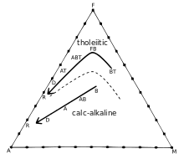
As magmas cool, they precipitate out significantly more iron and magnesium than alkali, causing the magmas to move towards the alkali corner as they cool.
In the tholeiitic magma, as it cools and preferentially produces magnesium-rich crystals, the magnesium content of the magma plummets, causing the magma to move away from the magnesium corner until it runs low on magnesium and simply moves towards the alkali corner as it loses iron and any remaining magnesium.
With the calc-alkaline series, however, the precipitation of magnetite causes the iron-magnesium ratio to remain relatively constant, so the magma moves in a straight line towards the alkali corner on the AFM diagram
FeO
Alk
MgO

Slide 114
Basalt magmas are partial melts of peridotite peridotite (olivine and pyroxene) produced by decompression melting in the Earth's mantle, a process described for igneous rocks.
Tholeiitic basalts are the most common volcanic rocks on Earth, as they are produced by submarine volcanism at mid-ocean ridges and make up much of the ocean crust.
MORB, the acronym for typical mid-ocean-ridge basalt, is a type of tholeiitic basalt particularly low in incompatible elements.
In contrast, alkali basalt is not typical at ocean ridges, but is erupted on some oceanic islands and on continents.

Slide 115
Basalts and Ultramafic Volcanic Rocks
Basalt: pl, augite, hypersthene, olivine, spinel (45-52 SiO₂)
Ultramafic volcanics :
komatiite : olivine, high Mg, low Ti
kimberlite : olivine, phlogopite, matrix (diatreme, brecciated)

Slide 116
Classification of Igneous Rocks
Figure 2-2. A classification of the phaneritic igneous rocks. b. Gabbroic rocks. c. Ultramafic rocks. After IUGS.
Olivine
Dunite
90
Peridotites
Wehrlite
Harzburgite
Lherzolite
40
Orthopyroxenite
Olivine Websterite
Pyroxenites
10
(c)
10
Websterite
Orthopyroxene
Clinopyroxenite
Clinopyroxene

Slide 117
Occurrences
Rift volcanism: tensional forces (MORB) tholeiitic, tholeiitic-rhyolitic, andesite (rare)
Subduction zone volcanism: compressional setting (andesite, dacite, rhyolite) composite volcano. diverse basalt (calc-alkaline ~ tholeiitic)
Intraplate volcanism: hot spot environment- OIB, LIPs(Large Igneous Proveince)

Slide 118
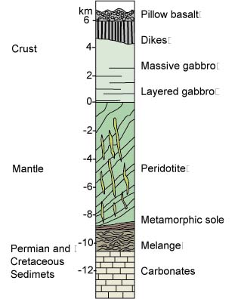
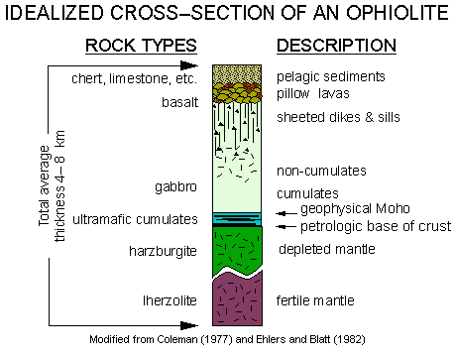

Slide 119
Alkali vs. Silica diagram for Hawaiian volcanics:
Seems to be two distinct groupings: alkaline and subalkaline
12
10
Alkaline
8
%Na₂O + K₂O
6
4
2
Subalkaline
35
40
45
50
55
60
65
%SiO₂

Slide 120
AFM diagram: can further subdivide the subalkaline magma series into a tholeiitic and a calc-alkaline series
Figure 8-14. AFM diagram showing the distinction between selected tholeiitic rocks from Iceland, the Mid-Atlantic Ridge, the Columbia River Basalts, and Hawaii (solid circles) plus the calc-alkaline rocks of the Cascade volcanics (open circles). From Irving and Baragar (1971).
F
h
o
l
e
T
i
i
t
i
c
Calc-alkaline
A
M

Slide 121
2. Calc-alkaline series
Moderately alkaline, more magnesian
Metaluminous to peraluminous BADR,
Calc-alkaline series are mostly found in convergent margins. They correspond to melting by adding water to the source (and therefore “shifting” the solidus towards lower temperatures).
The calc-alkaline magma series is one of two main magma series in igneous rocks, the other magma series being the tholeiitic. A magma series is a series of compositions that describes the evolution of a mafic magma, which is high in magnesium and iron and produces basalt or gabbro, as it fractionally crystallizes to become a felsic magma, which is low in magnesium and iron and produces rhyolite or granite.
Calc-alkaline rocks are rich in alkaline earths (magnesia and calcium oxide) and alkali metals and make up a major part of the crust of the continents.
The diverse rock types in the calc-alkaline series include volcanic types such as basalt, andesite, dacite, rhyolite, and also their coarser-grained intrusive equivalents (gabbro, diorite, granodiorite, and granite). They do not include silica-undersaturated, alkalic, or peralkaline rocks.
When mafic (basalt-producing) magmas crystallize, they preferentially crystallize the more magnesium-rich and iron-poor forms of the silicate minerals olivine and pyroxene, causing the iron content of tholeiitic magmas to increase as the melt is depleted of iron-poor crystals. (Magnesium-rich olivine solidifies at much higher temperatures than iron-rich olivine.)
Calc-alkaline magmas are typically hydrous, and also typically are more oxidized, with higher oxygen fugacities.

Slide 122
Calc-alkaline rocks typically are found in the arcs above subduction zones, commonly in volcanic arcs, and particularly on those arcs on continental crust.
Rocks in the series are thought to be genetically related by fractional crystallization and to be at least partly derived from magmas of basalt or andesite composition formed in the Earth's mantle.
Trends in composition can be explained by a variety of processes. Many explanations focus on water content and oxidation states of the magmas. Proposed mechanisms of formation begin with partial melting of subducted material and of mantle peridotite (olivine and pyroxene) altered by water and melts derived from subducted material. Mechanisms by which the calc-alkaline magmas then evolve may include fractional crystallization, assimilation of continental crust, and mixing with partial melts of continental crust.

Slide 123
1. Alkaline series
Alkali rich, iron poor
Metaluminous to peralkaline
Evolution towards trachytes (moderaltely alkaline series) or phonolites (very alkaline series), that can feature riebeckite, aegyrine, etc.
Alkaline series are found in intra-plate situations ± convergent margins. They correspond to melting by increase of temperature.
Alkali basalt or alkali olivine basalt is a fine-grained, dark-coloured, volcanic rock characterized by phenocrysts of olivine, titanium-rich augite, plagioclase feldspar and iron oxides. For similar SiO₂ concentrations, alkali basalts have a higher content of the alkalis, Na₂O and K₂O, than other basalt types such as tholeiites. They are also characterized by the development of modal nepheline in their groundmass. normative nepheline in their CIPW norms. Alkali basalts are typically found on updomed and rifted continental crust, and on oceanic islands such as Hawaii.

Slide 124
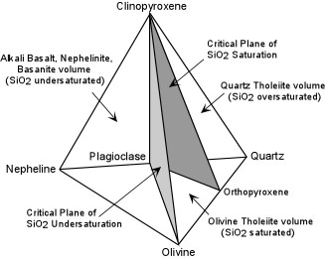
Basalts
On a chemical basis, basalts can be classified into three broad groups based on the degree of silica saturation. This is best seen by first casting the analyses into molecular CIPW norms (the same thing as CIPW norms except the results are converted to mole % rather than weight %). On this basis, most basalts consist predominantly of the normative minerals - Olivine, Clinopyroxene, Plagioclase, and Quartz or Nepheline.

Slide 125
The plane Cpx-Plag-Opx is the critical plane of silica saturation. Compositions that contain Qtz in their norms plot in the volume Cpx-Plag- Opx-Qtz, and would be considered silica oversaturated. Basalts that plot in this volume are called Quartz Tholeiites.
2. The plane Ol - Plag - Cpx is the critical plane of silica undersaturation. Normative compositions in the volume between the critical planes of silica undersaturation and silica saturation are silica saturated compositions (the volume Ol - Plag - Cpx - Opx). Silica saturated basalts are called Olivine Tholeiites.

Slide 126
3. Normative compositions that contain no Qtz or Opx, but contain Ne are silica undersaturated (the volume Ne-Plag-Cpx-Ol). Alkali Basalts, Basanites, Nephelinites, and other silica undersaturated compositions lie in the silica undersaturated volume.

Slide 127
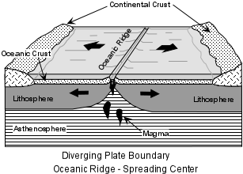
Mid Ocean Ridge Basalts (MORBs)
The Oceanic Ridges are probably the largest producers of magma on Earth. Yet, much of this magmatism goes unnoticed because, with the exception of Iceland, it all takes place below the oceans. This magmatism is responsible for producing oceanic crust at divergent plate boundaries.
At most oceanic ridges the basalts that are erupted are tholeiitic basalts sometimes referred to as NMORBs (normal MORBs).

Slide 128
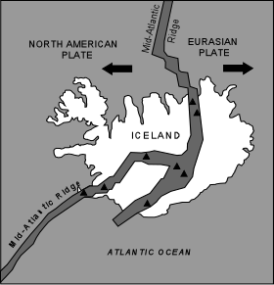
At Iceland, the rate of magma production is so high that volcanism has built the oceanic ridge above sea level. Most of the active volcanism occurs within two central rift zones that cut across the island. Again, the predominant type of basalts erupted are tholeiitic basalts, however, these are somewhat different from NMORBs, showing higher concentrations of incompatible trace elements. Thus, they are often referred to as Enriched MORBs (EMORBs).
Unlike normal oceanic ridges, a significant volume of rhyolite is also erupted in Iceland. This was once thought to suggest that continental crust underlies Iceland, but it is more likely that the rhyolites are produced by either crystal fractionation of the basalts or partial melting of the oceanic crust beneath Iceland.

Slide 129
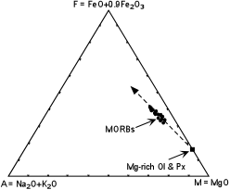
Composition
At the oceanic ridges, the basalts erupted range in composition from Olivine tholeiites to Quartz tholeiites. The compositions are by and large restricted to basalt, i.e. less than about 52% SiO₂. The diagram shown here is called an AFM diagram. It is a triangular variation diagram that plots total alkalies at the A corner, total iron at the F corner, and MgO at the M corner. As shown, MORBs show a restricted range of compositions that fall along a linear trend extending away from the compositions of Mg-rich pyroxenes and olivines.
This is the trend that would be expected from fractional crystallization involving the removal of early crystallizing olivines and pyroxenes from a tholeiitic basaltic liquid. Note that the trend is often referred to as an Fe-enrichment trend.

Slide 130
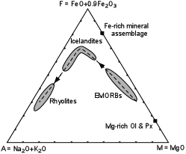
The rock suite erupted at Iceland shows a much broader range of chemical compositions. While EMORBs predominate, intermediate rocks like icelandites and siliceous rocks like rhyolites also occur. Plotted on an AFM diagram, we see that the EMORBs show a range of compositions that likely result from crystal fractionation of early crystallizing Mg-rich olivines and pyroxenes. With continued fractionation, the liquids follow an Fe enrichment trend to produce the Icelandites.

Slide 131
During this sequence the olivines and pyroxenes are expected to become more Fe enriched which would tend to cause the trend to bend somewhat. But at the peak of Fe enrichment it appears that the liquids have become so rich in Fe that an Fe-rich phase, like magnetite, joins the early crystallizing mineral assemblage. Fractionation of this Fe-rich mineral assemblage would then cause Fe to become depleted in successive liquids, driving the liquid compositions toward rhyolite. Thus, crystal fractionation appears to be responsible for the main variety of rocks found at Iceland.

Slide 132
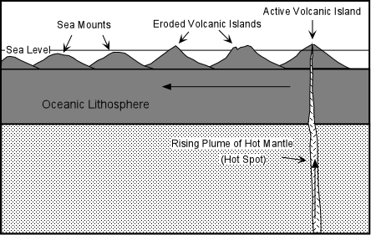
Ocean Island Basalts (OIBs)
The oceanic islands are, in general, islands that do not occur along the divergent or convergent plate boundaries in the ocean basins. Nevertheless, EMORBs, such as those that occur in Iceland, as well as the Alkalic basalts of Iceland have much in common with magmas erupted in the oceanic islands. In the Atlantic Ocean, which is a slow-spreading oceanic basin, as well as in the Galapagos Islands of the eastern Pacific Ocean, some of the islands occur close to oceanic ridge spreading centers.

Slide 133
Ocean Island Basalts (OIBs)
Ocean island basalts are found on islands and volcanoes located on oceanic crust. The chemical composition of these basalts can vary from tholeiite to alkali basalt within the same island group, but it is never calc-alkaline. During the shield volcano stage of many hotspot islands, tholeiitic OIBs build up most of the volcano's structure. Following the post-erosional stage this is usually accompanied by violent eruptions of alkali basalt and other more evolved volcanic rocks with high alkali content.
The existence of basaltic eruptions in the interior of tectonic plates, however, is not directly related to plate tectonism and models involving magma upwelling from deep mantle sources (such as mantle plumes and hotspots) have been developed to explain this intra-plate volcanism. These models explain why OIBs contain more geochemically enriched basalt than mid-ocean ridge basalts (MORBs) that originate from much closer to the Earth's surface in the asthenosphere.

Slide 134
Composition
Unlike the ocean ridges, which have a rather limited range of rock compositions, the oceanic islands have produced a broader range. Basalts are still predominant, but other compositions are part of the series, and the types of rocks produced are variable from one island to the next. Some produce tholeiitic rocks similar to EMORBs and others produce alkalic basalts that are saturated to undersaturated with respect to silica.

Slide 135
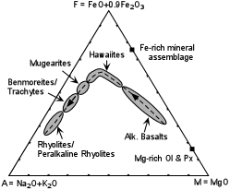
here is the more common alkaline suite produced at oceanic islands. The most basic rocks are alkaline basalts that show a range of compositions and an Fe-enrichment trend that likely results from fractionation of Mg-rich olivines and pyroxenes. As these magmas become more enriched in iron, hawaiites are produced. The fractionating assemblage then becomes more Fe-rich, likely caused by the addition of magnetite to the crystallizing assemblage. This causes an Fe-depletion trend causing magmas to evolve to mugearites, benmoreites or trachytes, and eventually rhyolites and/or peralkaline rhyolites

Slide 136
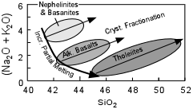
In terms of total alkalies and silica the three suites of rocks each show trends of increasing alkalies with increasing SiO₂.
In basic magmas the alkaline elements K and Na behave as incompatible elements, so crystallization of Mg & Fe- rich phases tends to cause both SiO2 and alkalies to increase. Thus the general trends are consistent with crystal fractionation as a mechanism to explain chemical variation in each suite.

Slide 137
II.Trace elements
Though trace elements, by definition, constitute only a small fraction of a system of interest, they provide geochemical and geological information out of proportion to their abundance. There are several reasons for this:
First, variations in the concentrations of many trace elements are much larger than variations in the concentrations of major components, often by many orders of magnitude.

Slide 138
Second, in any system there are far more trace elements than major elements. In most geochemical systems, there are 10 or fewer major components that together account for 99% or more of the system. This leaves 80 trace elements. Each element has chemical properties that are to some degree unique, hence there is unique geochemical information contained in the variation of concentration for each element. Thus the 80 trace elements always contain information not available from the variations in the concentrations of major elements.

Slide 139
Third, the range in behavior of trace elements is large and collectively they are sensitive to processes to which major elements are insensitive. One example is the depth at which partial melting occurs in the mantle.
When the mantle melts, it produces melts whose composition is only weakly dependent on pressure, i.e., it always produces basalt. Certain trace elements, however, are highly sensitive to the depth of melting (because the phase assemblages are functions of pressure). Furthermore, on a large scale, the composition of the Earth’s mantle appears to be relatively uniform, or at least those parts of it that give rise to basaltic magmas. Indeed, it has proved very difficult to demonstrate any heterogeneity in the mantle on the basis of the major element chemistry of the magmas it has produced. In contrast, it has been amply demonstrated that trace element concentrations of the mantle are quite variable.

Slide 140
Trace elements
Trace elements are those elements that are not stoichiometric constituents of phases in the system of interest
A trace element in one system is not one in another.
For example, potassium never forms its own phase in mid-ocean ridge basalts (MORB), its concentration rarely exceeding 1500 ppm; but K is certainly not a trace element in granites. For most silicate rocks, O, Si, Al, Na, Mg, Ca, and Fe are ‘major elements’.
C, S, K, P, Ti, Cr, and Mn are sometimes ‘major elements’ in the sense that they can be stoichiometric constituents of phases.
These are often referred to as ‘minor elements’.
All the remaining elements are always trace elements, with the exception of a few rare.

Slide 141
General characteristics of Trace elements
Trace elements are those which occur in very low concentrations in common rocks (usually < 0.1 % by weight).
Their concentrations are therefore commonly expressed in parts per million (ppm; 1 ppm = 10⁻⁴ weight%).
Unlike major elements, trace elements tend to concentrate in fewer minerals, and are therefore more useful in formulating models for magmatic differentiation, and in some cases, in predicting the source of a particular magma.
Trace elements most commonly used for the interpretation of the petrogenesis of igneous rocks include: Ni, Cr, Sc, V, Rb, Ba, Sr, Zr, Y, Nb and the rare earth elements (La to Lu).

Slide 142
Keep in mind that the concentration of trace elements will vary with the rock type; whereas Ni and Cr show higher concentrations in mafic and ultramafic rocks, Zr and Rb are more concentrated in acidic rocks.
Accordingly, some major or minor elements as K and P, which occur in very low concentrations in basalts (approaching trace levels), are just as useful in petrogenetic interpretations as some trace elements (in the case of basalts only, .. of course!).

Slide 143
Types of trace elements
In addition to this simple classification of trace elements into compatibles and incompatibles, trace elements are perhaps better classified on the basis of their geochemical characteristics (which will naturally influence whether the element becomes compatible or incompatible).
Large ion lithophile elements (LILE): These elements are characterized by large ionic radii, and low charges, and will therefore preferentially concentrate in the liquid until a particular phase with large enough sites to accommodate them begins to crystallize. These elements will therefore be largely "incompatible" particularly with respect to mantle phases (Ol, Opx, Cpx, Gt, .. etc). Examples include: K, Rb, Sr and Ba.
High field strength elements (HFSE): These are elements which have large cations, but also large charges, and are also excluded from mantle phases and more concentrated in residual liquids (i.e. they will be more incompatible). These elements are concentrated in accessory phases as sphene, zircon, and apatite. Examples include Zr, Hf, Nb, Ta, Th and U.

Slide 144
Types of trace elements
Transition elements: Trace elements which are also transition elements are characterized by relatively small ionic radii, and are either bi- or tri-valent. These elements are strongly partitioned in the solid phases that crystallize during the early stages of magmatic evolution, and are therefore "compatible" with mantle phases. Examples include Ni, Co, Cr, and Sc.
Rare earth elements (REE): This is a group of elements with atomic numbers between 57 (La) and 72 (Lu) characterized by relatively large ionic radii, and valences of either +2 or +3. They have proven to be very important for petrogenetic interpretations. However, these elements occur in very low concentrations in igneous rocks.

Slide 145
In geochemistry, compatibility is a measure of how readily a particular trace element substitutes for a major element within a mineral.
Compatibility of an ion is controlled by two things: its valence and its ionic radius. Both must approximate those of the major element for the trace element to be compatible in the mineral.
For instance, olivine (an abundant mineral in the upper mantle) has the chemical formula (Mg,Fe)₂SiO₄. Nickel, with very similar chemical behavior to iron and magnesium, substitutes readily for them and hence is very compatible in the mantle.

Slide 146
The compatibility of an element in a rock is a weighted average of its compatibility in each of the minerals present. By contrast, an incompatible element is one that is least stable within its crystal structure.
In general, when an element is referred to as being “compatible” without mentioning what rock it is compatible in, the mantle is implied. Thus incompatible elements are those that are enriched in the continental crust and depleted in the mantle. Examples include: rubidium, barium, uranium, and lanthanum. Compatible elements are depleted in the crust and enriched in the mantle, with examples nickel and titanium.

Slide 147
BEHAVIOR OF THE ELEMENTS
Goldschmidt’s Classification
Goldschmidt recognized four broad categories: atmophile, lithophile, chalcophile, and siderophile.
Atmophile elements are generally extremely volatile (i.e., they form gases or liquids at the surface of the Earth) and are concentrated in the atmosphere and hydrosphere.
Lithophile, siderophile and chalcophile refer to the tendency of the element to partition into a silicate, metal, or sulfide liquid respectively.

Slide 148
Lithophile elements are those showing an affinity for silicate phases and are concentrated in the silicate portion (crust and mantle) of the earth.
Siderophile elements have an affinity for a metallic liquid phase. They are depleted in the silicate portion of the earth and presumably concentrated in the core.
Chalcophile elements have an affinity for a sulfide liquid phase.

Slide 149
Goldschmidt's Classification of the Elements

Slide 150
Siderophile elements are mainly group 8, 9 & 10 elements (and their neighbors), chalcophile elements are mainly group 11,12 and the heavier group 13-16 elements, while the atomophile elements are mainly the noble gases.

Slide 151
Goldschmidt (1937) also advanced some simple rules for the qualitative prediction of trace element affinities, based solely on the ionic radius and valence:
1. Two ions with the same radius and valence should enter into solid solution in amounts proportional to their concentration. In other words, they should behave about the same. Using this rule, one can predict the general affinity for some trace elements by analogy with a major element with similar charge and radius. This type of substitution is often called camouflage. For example, Rb might be expected to behave as does K, and concentrate in K-feldspars, micas, and evolved melts. Ni, on the other hand, should behave like Mg and concentrate in olivine, and other early-forming mafic minerals.

Slide 152
2. If two ions have a similar radius and the same valence, the smaller ion is preferentially incorporated into the solid over the liquid. Because Mg is smaller than Fe, it should be preferred in solids, as compared to liquids. This is clearly demonstrated by noting the Mg/Fe ratio in olivine vs. liquid in the Fo-Fa system. Mg/Fe is always greater in olivine than in the coexisting melt.

Slide 153
3. If two ions have a similar radius but different valence, the ion with the higher charge is more readily incorporated into the solid over the liquid. Thus Cr⁺³ and Ti⁺⁴ are almost always preferred in solids as compared to liquids.

Slide 154
GOLDSCHMIDT’S RULES
1. The ions of one element can extensively replace those of another in ionic crystals if their radii differ by less than approximately 15%.
2. Ions whose charges differ by one unit substitute readily for one another provided electrical neutrality of the crystal is maintained. If the charges differ by more than one unit, substitution is generally slight.
3. When two different ions can occupy a particular position in a crystal lattice, the ion with the higher ionic potential forms a stronger bond with the anions surrounding the site.

Slide 155
RINGWOOD’S MODIFICATION OF
GOLDSCHMIDT’S RULES
4. Substitutions may be limited, even when the size and charge criteria are satisfied, when the competing ions have different electronegativities and form bonds of different ionic character.
This rule was proposed in 1955 to explain discrepancies with respect to the first three Goldschmidt rules.
For example, Na⁺ and Cu⁺ have the same radius and charge, but do not substitute for one another.

Slide 156
INCOMPATIBLE VS. COMPATIBLE TRACE ELEMENTS
Incompatible elements: Elements that are too large and/or too highly charged to fit easily into common rock-forming minerals that crystallize from melts. These elements become concentrated in melts.
Large-ion lithophile elements (LIL’s): Incompatible owing to large size, e.g., Rb⁺, Cs⁺, Sr²⁺, Ba²⁺, (K⁺).
High-field strength elements (HFSE’s): Incompatible owing to high charge, e.g., Zr⁴⁺, Hf ⁴⁺, Ta⁴⁺, Nb⁵⁺, Th⁴⁺, U⁴⁺, Mo⁶⁺, W⁶⁺, etc.
Compatible elements: Elements that fit easily into rock-forming minerals, and may in fact be preferred, e.g., Cr, V, Ni, Co, Ti, etc.

Slide 157
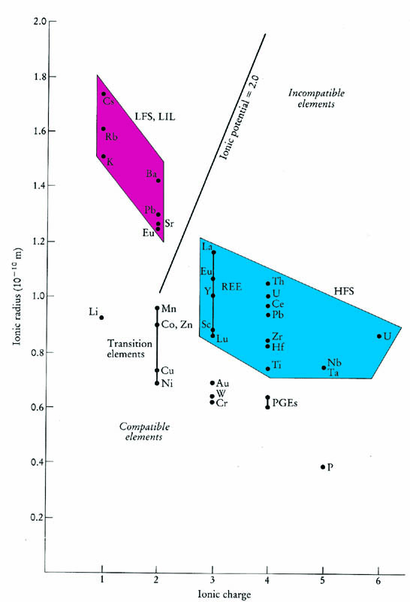
Incompatible elements commonly → two subgroups
  Smaller, highly charged high field strength (HFS) elements (REE, Th, U, Ce, Pb⁴⁺, Zr, Hf, Ti, Nb, Ta)
  Low field strength large ion lithophile (LIL) elements (K, Rb, Cs, Ba, Pb²⁺, Sr, Eu²⁺) are more mobile, particularly if a fluid phase is involved
Notes:
Depends on the minerals involved!
Sr -> melt as ol & px separate -> plag (Ca) & not melt if plag is phenocryst phase
Commonly standardized to mantle compositions (olivine, pyroxenes, and perhaps garnet)
Thus the major elements Mg and Fe would usually be referred to as compatible, while K and Na as incompatible

Slide 158
THREE TYPES OF TRACE-ELEMENT SUBSTITUTION
1) CAMOUFLAGE
2) CAPTURE
3) ADMISSION

Slide 159
CAMOUFLAGE
Occurs when the minor element has the same charge and similar ionic radius as the major element (same ionic potential).
Zr⁴⁺ (0.80 Å); Hf⁴⁺ (0.79 Å) (Same charge – similar ionic radius)
Hf usually does not form its own mineral; it is camouflaged in zircon (ZrSiO₄)

Slide 160
CAPTURE
Occurs when a minor element enters a crystal preferentially to the major element because it has a higher ionic potential (Ionic potential is the ratio of electric charge to the radius of an ion ) than the major element.
For example, K-feldspar captures Ba²⁺ (1.44 Å; Z/r = 1.39) or Sr²⁺ (1.21 Å; Z/r = 1.65) in place of K⁺ (1.46 Å, Z/r = 0.68).
Requires coupled substitution to balance charge: K⁺ + Si⁴⁺ ↔ Sr²⁺ (Ba²⁺) + Al³⁺
Ionic potential is an ion's charge divided by its radius, and it is thus a measure of density of charge. Ionic potential gives a sense of how strongly or weakly the ion will be electrostatically attracted to ions of opposite charge, and to what extent the ion will repel other ions of like charge.

Slide 161
ADMISSION
Involves entry of a foreign ion with an ionic potential less than that of the major ion.
Example Rb⁺ (1.57 Å; Z/r = 0.637) for K⁺ (1.46 Å, Z/r = 0.68) in K-feldspar.
The major ion is preferred.

Slide 162

Trace Elements in Igneous Processes
Alkalis
Transition Metals
Precious
Metals
Rare Earth Elements

Slide 163
Trace Element Compatibility
Compatibility – degree to which an element prefers to partition into the solid over the liquid phase .
Kd_{(i)}¹ – Mineral-Liquid Partition Coefficient for element i in mineral 1
Kd_{(i)}¹ = C_{(i)}^{mineral} ¹/ C_{(i)}^{liquid} (C_{(i)} - concentration of element i in wt. %)
Kd_{(i)}¹ > 1 – Compatible, Kd_{(i)}¹ < 1 – Incompatible
D_{(i)} – Bulk Rock Partition Coefficient for element i
D_{(i)} = x¹ Kd_{(i)}¹ + x² Kd_{(i)}² + x³ Kd_{(i)}³ + .... (x¹ – proportion of mineral 1)

Slide 164
Exchange equilibrium of a component i between two phases (solid and liquid)
i _{(liquid)} = i _{(solid)}
K =
K = equilibrium constant
a ^{solid}
a ^{liquid}
_{i}
_{i}

Slide 165
incompatible elements are concentrated in the melt
(K_{D} or D) « 1
compatible elements are concentrated in the solid
K_{D} or D » 1

Slide 166
Compatibility depends on minerals and melts involved.
Which are incompatible? Why?
Notes:
Not exact, since Δ varies with the composition of mins & melt

Slide 167
For a rock, determine the bulk distribution coefficient D for an element by calculating the contribution for each mineral
D_{i} = Σ W_{A} D_{i}
W_{A} = weight % of mineral A in the rock
D_{i} = partition coefficient of element i in mineral A
A
A

Slide 168
Mantle composition

Slide 169
D_{i} = Σ W_{A} D_{i}
W_{A} = weight % of mineral A in the rock
D_{i} = partition coefficient of element i in mineral A
bulk distribution coefficient D
Example: hypothetical garnet lherzolite = 60% olivine, 25% orthopyroxene, 10% clinopyroxene, and 5% garnet (all by weight), using the data in Table 9.1, is:
D_{Er} = (0.6 · 0.026) + (0.25 · 0.23) + (0.10 · 0.583) + (0.05 · 4.7) = 0.366
Notes:
Note that 85% Ol + Opx, but 5% Grt raises bulk D to 0.366

Slide 170
Sr and Ba (also incompatible elements)
    Sr is excluded from most common minerals except plagioclase
    Ba similarly excluded except in alkali feldspar
Notes:
Ba/Sr will help identify Kspar vs Plag
Both are incompatible -> first partial melts (or residual liquids of FX)
Effect depends on the mineral phases involved
Sr is excluded from most common minerals except plagioclase
Ba similarly excluded except in alkali feldspar
Thus the ratio Ba/Sr increases with crystallization of plagioclase, but may decrease when orthoclase begins to crystallize

Slide 171
Sr and Ba (incompatible elements)
    Sr is excluded from most common minerals except plagioclase
    Ba similarly excluded except in alkali feldspar
Ba/Sr will help identify Kspar vs Plag
  Effect depends on the mineral phases involved
Thus the ratio Ba/Sr increases with crystallization of plagioclase, but may decrease when orthoclase begins to crystallize (Why!?).
As plagioclase crystallize the amount of Sr in the residual melts decrease the Ba/Sr increase and vice versa.
Notes:
Ba/Sr will help identify Kspar vs Plag
Both are incompatible -> first partial melts (or residual liquids of FX)
Effect depends on the mineral phases involved
Sr is excluded from most common minerals except plagioclase
Ba similarly excluded except in alkali feldspar
Thus the ratio Ba/Sr increases with crystallization of plagioclase, but may decrease when orthoclase begins to crystallize

Slide 172
The rubidium in amphiboles is generally depleted with respect to potassium.
Partial melting of a mantle material such as amphibole peridotite would produce a liquid with a K:Rb ratio higher than that in the initial material.

Slide 173
K/Rb often used → the importance of amphibole in a source rock
  K & Rb behave very similarly, so K/Rb should be ~ constant
  If amphibole, almost all K and Rb reside in it
  Amphibole has a D of about 1.0 for K and 0.3 for Rb
K/Rb for amphibole:
Melt of amphibole-bearing rock will → increase K/Rb in the partial melt
Other factors being equal, a magma produced by partial melting of an amphibole-bearing source rock would have a higher K/Rb than one derived from amphibole-free source
High absolute K or Rb could also → an amphibole-bearing source, but may result from other causes (high phlogopite, or an alkali-enriched fluid)
The ratio is more indicative of amphibole due to the different D values
Fractional crystallization of amphibole would also → low K/Rb ratio in the evolved liquid
Notes:
K/Rb for amphibole:
Usually behave similarly, so ~ constant ratio
Unless amphibole which has a D of about 1.0 for K and 0.3 for Rb
almost all K and Rb reside in it
Melt of amphibole-bearing rock will -> decrease K/Rb in the partial melt
Other factors being equal, a magma produced by partial melting of an amphibole-bearing source rock would have a lower K/Rb than one derived from amphibole-free source
High absolute K or Rb could also → an amphibole-bearing source, but may result from other causes (high phlogopite, or an alkali-enriched fluid)
The ratio is more indicative of amphibole due to the different D values
Fractional crystallization of amphibole would also -> low K/Rb ratio in the evolved liquid

Slide 174
Compatible example:
Ni strongly fractionated → olivine > pyroxene
Cr and Sc → pyroxenes » olivine
Ni/Cr or Ni/Sc can distinguish the effects of olivine and augite in a partial melt or a suite of rocks produced by fractional crystallization
Notes:
In all of the above cases using ratios, the idea is to find a mineral with a unique pair of elements for which it alone has a relatively high value of D for one element and a relatively low value of D for the other. The ratio of these elements is then sensitive only to liquid/crystal fractionation associated with that particular mineral

Slide 175
A brief summary of some particularly useful trace elements in igneous petrology
Element
Use as a petrogenetic indicator
Ni, Co, Cr
Highly compatible elements. Ni (and Co) are concentrated in olivine, and Cr in spinel and
clinopyroxene. High concentrations indicate a mantle source.
V, Ti
Both show strong fractionation into Fe-Ti oxides (ilmenite or titanomagnetite). If they behave
differently, Ti probably fractionates into an accessory phase, such as sphene or rutile.
Zr, Hf
Very incompatible elements that do not substitute into major silicate phases (although they may
replace Ti in sphene or rutile).
Ba, Rb
Incompatible element that substitutes for K in K-feldspar, micas, or hornblende. Rb substitutes
less readily in hornblende than K-spar and micas, such that the K/Ba ratio may distinguish these
phases.
Sr
Substitutes for Ca in plagioclase (but not in pyroxene), and, to a lesser extent, for K in K-
feldspar. Behaves as a compatible element at low pressure where plagioclase forms early, but
as an incompatible at higher pressure where plagioclase is no longer stable.
REE
Garnet accommodates the HREE more than the LREE, and orthopyroxene and hornblende do
2+
so to a lesser degree. Sphene and plagioclase accommodates more LREE. Eu
is strongly
partitioned into plagioclase.
Y
Commonly incompatible (like HREE). Strongly partitioned into garnet and amphibole. Sphene
and apatite also concentrate Y, so the presence of these as accessories could have a
significant effect.
After Green (1980). Tectonophys., 63, 367-385. From Winter (2001) An Introduction to Igneous and Metamorphic Petrology. Prentice Hall.

Slide 176
Trace Element Fractionation
During Partial Melting

Slide 177
Differentiation of the Earth
Melts extracted from the mantle rise to the crust, carrying with them their “enrichment” in incompatible elements
  Continental crust becomes “incompatible element enriched”
  Mantle becomes “incompatible element depleted”

Slide 178
Don`t forget
compatible elements are commonly subdivided into two subgroups based on the ratio of valence to ionic radius.
The smaller, more highly charged high field strength (HFS) elements include the REE, Th, U, Ce, Pb⁴⁺, Zr, Hf, Ti, Nb, and Ta.
The low field strength large ion lithophile (LIL) elements (K, Rb, Cs, Ba, Pb²⁺, Sr, Eu²⁺) are generally considered to be more mobile, particularly if a fluid phase is involved.
Small, low valence elements are usually compatible, including the trace elements Ni, Cr, Cu, W, Ru, Rh, Pd, Os, Ir, Pt, and Au.

Slide 179
The Rare Earth Elements and Y
THE RARE EARTH ELEMENTS: A SPECIAL GROUP OF TRACE ELEMENTS
The lanthanides comprise a group of 15 elements with atomic numbers 57 through 71 that include the following in order of atomic number (atomic symbol): lanthanum (La), cerium (Ce), praseodymium (Pr), neodymium (Nd), promethium (Pm), samarium (Sm), europium (Eu), gadolinium (Gd), terbium (Tb), dysprosium (Dy), holmium (Ho), erbium (Er), thulium (Tm), ytterbium (Yb), and lutetium (Lu).
The rare earths are often described as being a "light-group rare-earth element" (LREE) or "heavy-group rare-earth element" (HREE). The definition of a LREE and HREE is based on the electron configuration of each rare-earth element. The LREE are defined as lanthanum, atomic number 57 through gadolinium, atomic number 64.

Slide 180
The Rare Earth Elements and Y
THE RARE EARTH ELEMENTS: A SPECIAL GROUP OF TRACE ELEMENTS
The rare earth elements (REE), the series from lanthanum to lutetium (atomic numbers 57-71), are members of Group III A of the periodic table.
They all have similar chemical and physical properties, causing them to behave as a coherent series (the "lanthanide series").
They all have a 3+ oxidation state, as a rule, and their ionic radius decreases steadily with increasing atomic number (called the lanthanide contraction). The decrease in ionic radius causes the heavy REE to be favored in most solids over the coexisting liquids (Goldschmidt's rule #2; slide 125)

Slide 181
The rare earths are transition metals.
Ionic radius, which decreases progressively from La3+ (115 pm) to Lu3+ (93pm), illustrated in the present Figure,
is thus the characteristic that governs their relative behavior.
Note that plagioclase, for example, is insensitive to the effect of ionic radius, whereas garnet strongly favors the heavy rare earth elements (HREE). This slight fractionation, commonly mineral-specific, in an otherwise coherent series makes the REE a valuable tool for petrologists.

Slide 182
A further use of trace element partitioning is the identification of the source rock or a particular mineral involved in either partial melting or fractional crystallization processes. For example, the REE can commonly be used to distinguish between high pressure and low pressure sources of a mantle-derived melts.
In the deep continental crust, and at depths over about 70 km in the mantle, garnet and clinopyroxene are important phases, and remain as residual solids during the generation of up to 15 to 20% partial melts. As a result, particularly due to the presence of garnet, the bulk distribution coefficient will be high for the HREE, and up to 10% partial melts will be highly HREE depleted (with highly negative slope on a REE diagram.

Slide 183
Because the slope on a REE diagram is also a function of F, the fraction of melt generated, we must be aware of the differences between HREE depletion by garnet and LREE enrichment due to low degrees of partial melting.
At depths shallower than 40 km, plagioclase is an important phase and can be detected via an Eu anomaly in the melt. Thus the shape of the REE pattern of some mantle-derived basalts may yield important information on their depth of origin.

Slide 184
Because of their high charge and large radii, the rare earths are incompatible elements.
Incompatible elements are defined as those elements that partition readily into a melt phase when the mantle undergoes melting.
The degree of incompatibilities varies, however. Highly charged U and Th are highly incompatible elements, as are the lightest rare earths. However, the heavy rare earths have sufficiently small radii that they can be accommodated to some degree in many common minerals. The heaviest rare earths readily substitute for Al3+ in garnet, and hence can be concentrated by it.

Slide 185
Eu, when in its ²⁺ state, substitutes for Ca²⁺ in plagioclase feldspar more readily than the other rare earths. Thus plagioclase is often anomalously rich in Eu compared to the other rare earths, and other phases in equilibrium with plagioclase become relatively depleted in Eu as a consequence.

Slide 186
Rare earth patterns for upper continental crust and average mid-ocean ridge basalt (MORB) are also shown in Figure.
MORB exhibits a light rare earth depleted pattern; upper continental crust is light rare earth-enriched with a negative ‘Eu anomaly’.
The light rare earth depletion of MORB reflects the incompatible element-depleted nature of the upper mantle from which these magmas are derived. This incompatible element depletion of the mantle is generally thought to have resulted from extraction of partial melts, in which the incompatible elements were concentrated. Those partial melts have crystallized to form the continental crust.

Slide 187
A negative Eu anomaly is typical of many continental rocks, as well as most sediments and seawater.
The Eu anomaly probably arises because many crustal rocks of granitic and granodioritic composition were produced by intracrustal partial melting. The residues of those melts were rich in plagioclase, hence retaining somewhat more of the Eu in the lower crust, and creating a complimentary Eu-depleted upper crust. Sediments and seawater inherit this Eu anomaly from their source rocks in the upper continental crust.

Slide 188
Next lecture

Slide 189
MORB PETROGRAPHY AND MAJOR ELEMENT CHEMISTRY???
A "typical" MORB is an olivine tholeiite, with low K₂O (< 0.2%) and low TiO₂ (< 2.0%) compared to most other basalts. This makes MORBs chemically distinctive from basalts of other petrogenetic associations.
Textures range from glassy to phyric, and rarely to gabbroic among seabed samples.
Glass samples are very important chemically, because they represent liquid compositions, whereas the chemical composition of phyric samples can be modified by crystal accumulation processes.
Common phenocrysts are plagioclase (An₄₀-An₈₈), olivine (Fo₆₅-Fo₉₁), and a Mg-Cr spinel .
Ca-rich clinopyroxene phenocrysts are much less common, and usually occur in rocks with abundant olivine and plagioclase, suggesting that clinopyroxene is most commonly a late crystallizing phase.
The ground-mass mineralogy of MORBs is dominated by plagioclase and clinopyroxene microlites and a Fe-Ti oxide phase. From textures and experiments on natural samples at low pressure, the common crystallization sequence is:
olivine (± Mg-Cr spinel) —» olivine + plagioclase (± Mg-Cr spinel) —> olivine + plagioclase + clinopyroxene.

Slide 190
More extensive sampling and chemical work, however, has shown MORBs display a range of compositions. The range, however, is still considerably more restricted than for most petrogenetic associations. Table 13-2 lists some averaged chemical analyses of mid-ocean ridge basalts from the Atlantic, Pacific, and indian ocean ridges.
We can thus distinguish between N-MORB ("normal" MORE), which taps the depleted, or incompatible-poor mantle and E-MORB ("enriched" MORE, also called P-MORB for "plume") which taps the deeper, incompatible-richer mantle.
N-MORBs with Mg# > 65 have K2O < 0.10, and TiO2 < 1.0, whereas E-MORBs have K2O > 0.10 and TiO2 > 1.0 for the same Mg#. Of course, major element chemical composition is not the best way to make these distinctions, which must be substantiated by trace element and isotopic differences.

Slide 191
Chemical Analyses of MORB

Slide 192

Diagrams for MORB
Figure shows such a diagram for eight elements vs. Mg, with the Mg concentration decreasing from left to right. Mg is often plotted this way because lower Mg concentrations represent lower temperatures. Evolution of basaltic magmas usually involve a decrease in the Mg/Fe^{2+.}. The change in Mg concentration is from about 9.2% down to 6.8%, or more than 25% change. Silica changes only from 49% to about 51.6%, a variation of just over 5%.
Trends obvious in the diagram are an increase in silica, consistent with the magma becoming slightly more felsic, as mafic minerals crystallize. Ferrous iron concentrations are increasing, presumably as Fe²⁺ replaces Mg. Removal of early formed olivine would decrease the Mg/Fe²⁺ concentration. Calcium and alumina concentrations drop. This is consistent with the removal of early formed plagioclase. The alkalis (sodium and potassium), titanium, and phosphorous concentrations are all increasing. Sodium is included in plagioclase, but the plagioclase is anorthitic, so despite some sodium removal, it is still enriched in the melt. Potassium, titanium, and phosphorous are not removed in any crystallizing phase, and are highly enriched in the fluid phase.
Notes:
Figure 13-6 shows such a diagram for eight elements vs. Mg, with the Mg concentration decreasing from left to right. Mg is often plotted this way because lower Mg concentrations represent lower temperatures. Evolution of basaltic magmas usually involve a decrease in the Mg/Fe^{2+.} Silica concentration varies little and is thus a poor choice for the abscissa. The change in Mg concentration is from about 9.2% down to 6.8%, or more than 25% change. Silica changes only from 49% to about 51.6%, a variation of just over 5%. Note that this data is from the Amar Valley, MAR, not the AFAR triangle, as stated in the figure caption.
Trends obvious in the diagram are an increase in silica, consistent with the magma becoming slightly more felsic, as mafic minerals crystallize. Ferrous iron concentrations are increasing, presumably as Fe²⁺ replaces Mg. Removal of early formed olivine would decrease the Mg/Fe²⁺ concentration. Calcium and alumina concentrations drop. This is consistent with the removal of early formed plagioclase. The alkalis (sodium and potassium), titanium, and phosphorous concentrations are all increasing. Sodium is included in plagioclase, but the plagioclase is anorthitic, so despite some sodium removal, it is still enriched in the melt. Potassium, titanium, and phosphorous are not removed in any crystallizing phase, and are highly enriched in the fluid phase.

Slide 193
MORB TRACE ELEMENT
Variation diagrams for trace elements vs. Mg# support the conclusions stated above for the major element trends. Highly compatible elements, such as Ni and Cr, decrease with decreasing Mg#, as we would expect with olivine fractionation. Highly incompatible elements, such as V, concentrate in the evolved liquids. If we want to address the distinction between P-MORB and E-MORB, however, we are best served by proceeding directly to the rare earth elements .

Slide 194

REE Patterns for MORBS
The LREE patterns show a negative slope for the E-MORB's, but overall LREE enrichment.
The N–MORB shows a large LREE depletion, and a positive slope. The HREE patterns for both types are similar.
Since samarium is about halfway between lanthanum and lutetium, and is not plagued with anomalous behavior like europium, it has been suggested that the La/Sm ratio might be a useful distinguishing factor among basalts.

Slide 195






Trace Elements
E-MORBs (squares) enriched over N- MORBs (red triangles) and T-MORBs (green dots) regardless of Mg#
E-MORBs La/Sm > 1.8
N-MORBs La/Sm < 0.7
T-MORBs (transitional) intermediate values
Data from Schilling et al. (1983)

Slide 196
Conclusions:
MORBs have multiple source regions
The mantle beneath the ocean basins is not homogeneous
  N-MORBs tap an upper, depleted mantle
  E-MORBs tap a deeper enriched source
  Idea:
  T-MORBs = mixing of N- and E- magmas during ascent and/or in shallow chambers
Notes:
The time required for the isotopic systems to develop suggests that these reservoirs have been distinct for a very long time

Slide 197
Characteristic features of MORB:
Dominant phenocrysts are olivine followed by plagioclase. Only the more evolved compositions have
clinopyroxene phenocrysts, commonly after olivine phenocrysts have disappeared, presumably because of
the olivine reaction relationship.
Hypersthene and olivine normative tholeiitic basalts with a relatively restricted compositional range
corresponding to a density minimum along their liquid line of descent.
Primitive lava compositions (high MgO) are the most Fe-poor tholeiitic basalts on the Earth.
Combined high Al (Al₂O₃ = 15-18 wt.%) and high Ca (CaO = 11-13 wt.%), primitive OIB or Hotspot
tholeiitic basalts commonly have low Al (< 15 wt.% Al₂O₃) and low Ca (≤ 10 wt.% CaO).
The Lowest oxidation states (Fe³⁺/∑Fe = 0.05 - 0.10) of all basaltic magmas.
N-MORB are the most depleted of modern lavas in terms of incompatible trace elements, especially
LIL elements (K, Rb, Ba) and LREE. They are, however, relatively rich in HREE, which are relatively
unfractionated.

Slide 198

Petrographic Characteristics of MORB
Picrites (MgO > 12 wt.%)
Relatively rare,
Highly porphyritic lavas (20+%) with olivine megacrysts to Fo 91.
Olivine basalts (MgO = 10 - 12 wt.%)
Porphyritic basalts with more olivine than plag. phenocrysts.
Predominate along the central ridge axis and valley floor.
Olivine - plagioclase basalts (MgO ≤ 10 wt.%).
Porphyritic basalts with plag. more abundant than olivine.
More common on central valley scarps and walls.
Plagioclase basalts (Al₂O₃ ≥ 19 wt.%)
Highly porphyritic basalts with plag. megacrysts to An 90.
Probably represent plag. cumulates.
Plagioclase - clinopyroxene basalts (MgO ≤ 7 wt.%)
Relatively aphyric basalts with minor cpx and plag.
No olivine microphenocrysts.
Most common as diabase dykes and sills.

Slide 199
Oceanic Intraplate Volcanism
Why are we so interested in oceanic basalts?
● Oceanic basalts are uncontaminated by continental crust
● Therefore their compositions tell us something about their respective mantle sources
● MORB provides information about the upper depleted mantle
● OIB provides information about the lower (more fertile (primitive?)) mantle

Slide 200
Types of OIB Magmas
Two principal magma series
● Tholeiitic series (dominant type)
✦ Parental ocean island tholeiitic basalt, or OIT
✦ Similar to MORB, but with distinct chemical and mineralogical differences
● Alkaline series (subordinate)
✦ Parental ocean island alkaline basalt, or OIA
Some islands are dominated by tholeiitic basalts (and their derivatives) (e.g. Hawaii and Reunion) others by alkali basalts (and their derivatives) (e.g. Tahiti and Tristan de Cunha)

Slide 201
For the same Mg# OITs typically have higher K₂O, TiO₂, and P₂O₅, and lower Al₂O₃ than MORBs.
There is more overlap in the other major elements.
Magma types range from silica-saturated to slightly undersaturated olivine tholeiites to picrites.
Olivine (Fo₇₀–₉₀) is the dominant phenocryst phase in OITs, with Cr-spinel subordinate. Much of the evolution of tholeiitic series in OIBs can be modeled by fractional crystallization of olivine alone. The linear pattern for a Hawaiian tholeiite, for example, is different from the curved and kinked variation diagrams for MORBs where plagioclase and clinopyroxene crystallize as well.

Slide 202
Trace Elements
The large ion lithophile (LIL) trace elements (K, Rb, Cs, Ba, Pb²⁺ and Sr) are incompatible and are all enriched in OIB magmas with respect to MORBs
The ratios of incompatible elements have been employed to distinguish between source reservoirs
  N-MORB: the K/Ba ratio is high (usually > 100)
  E-MORB: the K/Ba ratio is in the mid 30’s
  OITs range from 25-40, and OIAs in the upper 20’s

Slide 203
Trace Elements
● HFS elements (Th, U, Ce, Zr, Hf, Nb, Ta, and Ti) are also incompatible, and are enriched in OIBs > MORBs.
OIAs tend to be depleted in Ni and Cr relative to OITs and MORBs, which, along with the higher Mg#s, suggests they have experienced fractionation of these phases prior to eruption.
● Ratios of these elements are also used to distinguish mantle sources
✦ The Zr/Nb ratio
▲ N-MORB generally quite high (>30)
▲ OIBs are low (<20)

Slide 204
OIA
● are characterized by higher alkali and lower silica content than tholeiites.
Because of the lower silica content, olivine is even more prevalent in OIAs, occurring in the groundmass as well as an ubiquitous phenocryst phase. Olivine also occurs over a broader range of the differentiated spectrum and has a greater
compositional range (Fo_{35–90}) than it does in OIT Olivine (Fo₇₀–₉₀)
There is usually only one pyroxene in OIAs, a brownish Ti-rich augite.
Amphibole is also an occasional phenocryst phase, indicating a higher volatile content.

Slide 205

Trace Elements: REEs
Note that ocean island tholeiites (OITs represented by the Kilauea and Mauna Loa samples) overlap with MORB and are not unlike E-MORB
The alkaline basalts have steeper slopes and greater LREE enrichment than the OIT’s. Some fall within the upper MORB field, but most are distinct

Slide 206
La /Yb (the overall slope on the REE diagram) is crudely proportional to the degree of silica undersaturation in OIBs.
Highly undersaturated magmas can have La / Yb in excess of 30, whereas OIA ratios are closer to 12, and OITs about 4.
Note also that the heavy REEs are also fractionated in the OIB samples in previous Figure. (as compared to the flat HREE patterns in N- and EMORB).
This indicates that garnet was a residual phase because it is one of the few common minerals that differentially incorporates HREE

Slide 207
From the consistent negative slopes in Figure, we can deduce that:
E-MORBs and OIBs (OIAs and OITs) are distinct from N-MORBs (positive slope) and appear to originate in an enriched mantle reservoir, although very low degrees of partial melting may also produce LREE-enriched melts from a primordial or slightly depleted source. MORB tholeiites probably originated in the depleted upper mantle, and alkali basalts in an enriched mantle reservoir (perhaps in the lower mantle).
E-MORB and ocean island tholeiites also have an enriched reservoir source.

Slide 208
GRANITOIDS-THEIR MINERALOGY,
GEOCHEMISTRY AND OCCURRENCE
The continental crust is commonly described as having a granitic composition.
This emphasises the contrast with the mafic rocks of the oceanic crust and ultramafic nature of the mantle, from which both the continental crust ultimately derives. However, there are important subtleties in the mineralogy and composition of silica rich rocks that have potential implications for their derivation and will therefore start with the classification of silica-rich, ‘granitic’ rocks, as more properly termed, granitoids.

Slide 209
Mineralogy and major elements
The term granitoid applies to the suite of felsic plutonic rocks whose compositions are summarised in Figure. The dominant minerals are quartz and various types of feldspar, the proportions of which define the rock type. Plagioclase predominates in tonalite, alkali feldspar in granite and both types are present in granodiorite.
Trondjhemite is a variety of tonalite that is unusually quartz rich and contains sodic, not calcic plagioclase. The proportion of mafic minerals varies from 20-40% in granodiorite and tonalite to only a few percent
in granite. Pyroxene is rare, the most common mafic minerals being hydrated species such as hornblende and biotite.

Slide 210

The mineralogy reflects the major-element compositions. Silica contents are high (60 to 75%), as are K2O contents, while elements such as TiO2, FeO, MgO and CaO, which are removed during the crystallisation of mafic minerals or calcic plagioclase, are low. The relative proportions of Al2O3 vs. CaO, Na2O and K2O form the basis of a classification of granite types.

Slide 211
In peralkaline granites, the molecular proportions of Al2O3 are greater than (Na2O + K2O);
In metaluminous granites Al2O3 > (CaO + Na2O + K2O) but Al2O3 > (Na2O + K2O);
and in peraluminous granites, Al2O3 > (CaO + Na2O + K2O).
These differences in element ratios impart distinctive mineralogies such as alkali pyroxene and amphibole in peralkaline granites and aluminous minerals such as muscovite, cordierite, garnet and rarely corundum in peraluminous granites.

Slide 212
I and S type granites
Chappell and White (1992, 2001) identified just two types of granite; S-types, where the “S” stands for “sedimentary”, and I-types, where the “I” stands for “igneous”.
General characterstics of S-Type granite:
They are strongly peraluminous,
Relatively potassic and have moderately high silica contents (64–77 wt % SiO2).
They contain low CaO, Na2O and Sr contents, elements that are lost when feldspar alters to clay minerals.
Their sedimentary source imparts a distinctive mineralogy – the presence of aluminous phases such as muscovite, cordierite and garnet.
Note that S-type granitoids normally intrude in relatively small volumes, particularly in active margins and continental collision zones.

Slide 213
General characterstics of I-Type granite:
They are metaluminous to weakly peraluminous.
Relatively sodic, and have a wide range of silica contents, from 56 to 77 % SiO2.
They typically contain hornblende and biotite.
In the original definition of Chappell and White, enclaves or xenoliths of diorite and gabbro or amphibolite are emphasised.
I-type granites are emplaced in large volumes in mature island arcs and convergent margins, as well as within Precambrian granite-greenstone terrains.
These rocks are the building blocks of the continental crust and most hypotheses for the origin of granitic magma apply specifically to them.

Slide 214
General characterstics of A-Type granite:
A-type granitoids are not associated with orogenesis – the “A” stands for “anorogenic”, “alkaline” or “anhydrous”.
They are rarely deformed and are thought to intrude after the main orogenic event.
They are perakaline and commonly contain pyroxene in the place of hydrous amphibole and biotite.

Slide 215
General characterstics of M-Type granite:
M-type granites, where the “M” stands for “mantle”, are said to be produced by partial melting of mantle peridotite or of “juvenile” basaltic crust.
A- and M-types are not common and do not play a major role in the formation of the continental crust.

Slide 217
Granitoid Rocks

Slide 218

Alumina saturation classes based on the molar proportions of Al₂O₃/(CaO+Na₂O+K₂O) (“A/CNK”) after Shand (1927). Common non-quartzo-feldspathic minerals for each type are included. After Clarke (1992). Granitoid Rocks. Chapman Hall.

Slide 219
amph calc-alkaline granite, K-rich calc-alkaline granite
muscovite peraluminous granite, cordierite peraluminous granite
(midocean) ridge tholeitic granite and
arc tholeiitic granite.
peralkaline and alkaline granite

Slide 220
Case Studies

